Slide 1
Entity Framework 6
27-Mar-18 | Start
25-Apr-18 | 118
26-Apr-18 | 164
07 May 18 | 3-30
Appendix
Online

Slide 2
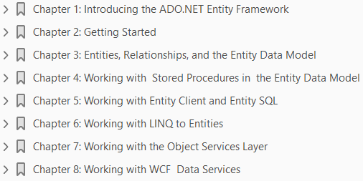
Entity Framework 6
Ch | Date
1 | 20 Apr 18
2 | 24 Apr 18
3 | 25 Apr 18
4 | 28 Apr 18
5
6
7
8
Entity Framework Tutorial 6 08 2015

Slide 3
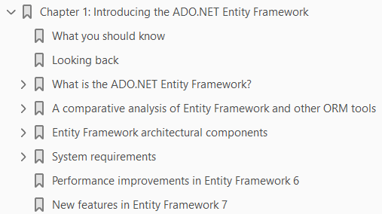
1
Introducing the ADO.NET Entity Framework

Slide 4
Intro
Welcome to our journey into mastering the popular data access technology from Microsoft named Entity Framework.
At the time of writing, Entity Framework 7 hasn't been released—so we will use Entity Framework 6.x throughout this book but at the same time discuss what's new in Entity Framework 7.
Object Relational Mapping (ORM) technology has been widely in use for over a decade.
ORMs are used to convert data between incompatible type systems.
These are tools that encapsulate calls to the underlying database and enable you to query and manipulate data using an object-oriented paradigm.
The Figure 1-1illustrates the persistence layer that is responsible for reading and manipulating data to and from the database.
Now, this persistence layer can be your
ADO.NET library
a wrapper around the ADO.NET library
an ORM

Slide 5
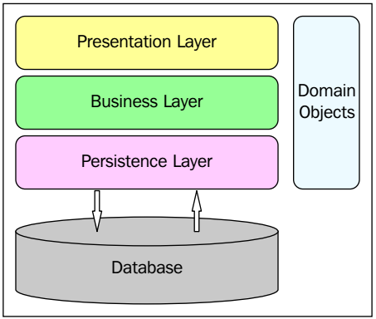
Figure 1-1

Slide 6
ADO.NET Entity Framework
We will explore more on ORMs later in this chapter.
The ADO.NET Entity Framework (EF) is an extended and open source
ORM technology from Microsoft that abstracts the object model of an application from its relational or logical model.
That is, it isolates the object model from the way the data is actually represented in the relational store.
This framework makes the conceptual model real by using an extended entity relationship model called the ADO.NET Entity Data Model (EDM).
In this book, we will examine Entity Framework 6 in order to leverage its existing and enhanced features to design and implement applications that are robust, high performing, persistence, ignorant, and scalable.
We will explore each of these features as we read through the chapters of this book.
This chapter will give you an introduction to Entity Framework and also provide you with a brief understanding of the related terminologies.
We will revisit each of the Entity Framework architectural components as we progress through this book.

Slide 7
Agenda
In this chapter, we will cover the following points:
An overview of Entity Framework
Entity Framework architectural components:
The Entity Data Model
LINQ to Entities
Entity Client
Entity SQL
The Object Services Layer
A comparative analysis of EF and other ORMs
New features and enhancements in Entity Framework 6:
Support for persistence ignorance
Support for T4 code generation
Support for lazy loading

Slide 8
Agenda |
Support for POCO change-tracking
Better n-tier support
Support for model-first and development
Support for built-in functions and UDF
Support for model-defined functions
Support for enums
Support for spatial data types
But, before we delve deep into this amazing technology from Microsoft, let's take a quick look at the prerequisites to learning the concepts covered in this book.

Slide 9
What you should know
As Entity Framework 7 has not been released and isn't mature yet, we will use Entity Framework 6.x in this book while discussing the features of Entity Framework 7 as we move ahead.
To learn the concepts covered in this book, you should have a basic understanding of the following:
Programming using ADO.NET
C# 5.0
Using the Visual Studio 2013 IDE
Working with the .NET console and web applications
SQL Server 2012 or later

Slide 10
Looking Back
Looking back Data-centric applications have two perspective layers. They are
the data model
the object model
While the data model defines the way data is defined and stored, the object model defines how the same data will be represented to the user in the presentation layer or how it is exposed to the other layers of the application.
The data model of the application usually deals with the storage and retrieval of the application's data to and from the relational store.
The relational store is used for data persistence, consistency, concurrency, and security.
It contains the application's data and typically comprises a set of tables, views, functions, procedures, and relationships.
You typically use T-SQL to query against the relational store, which returns result sets that contain columns and rows of data.
However, the data returned doesn't necessarily match the application's object-oriented programming model.

Slide 11
Looking Back |
Usually, we don't use the data returned in the same form in which it is returned from the relational store.
We write the necessary code to transform the data returned from the relational store into business objects in the data access layer of the application.
Similarly, you need to write code to transform your application's business objects into a form that can be persisted into your relational store.
But, what if the schema of the underlying relational store changes?

Slide 12
ORM
Here's exactly where an ORM fits in.
The Figure 1-2 shows how objects in an application can be mapped to the relational store by using a mapping layer. This mapping layer is provided by the ORM.
An ORM is a method of representing the relational tables as entities in the object world.
ORMs came onto the market to provide you with a framework using which you can connect your applications to the underlying database without having to write much code.
Most importantly, you can use ORMs to
connect to any database
increase development productivity
ensure database independence
database portability
To bridge this apparent mismatch between the data and the object models, ORM tools have evolved.

Slide 13
ORM |
They are used to reduce the code required to transform your application's business objects into a form that can be persisted into the relational store and vice-versa Figure 1-3.
Microsoft first released its ORM by the name of LINQ to SQL, which shipped with .NET 3.5 and Visual Studio 2008.
However, LINQ to SQL was restricted to working with SQL Server databases only.
Entity Framework is an attempt by Microsoft to provide you with an extended ORM built on top of the ADO.NET provider model and enable you to connect to and work with any database.

Slide 14
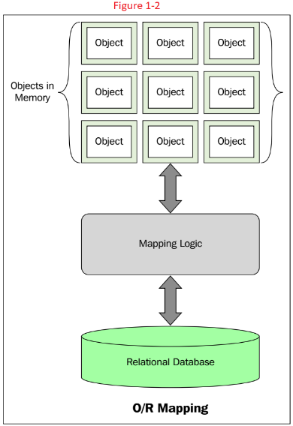
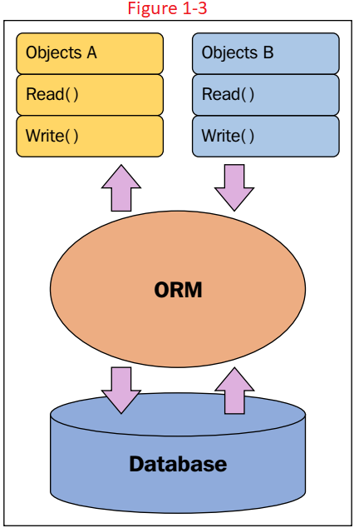
Figure 1-2 || 1-3

Slide 15
What is the ADO.NET Entity Framework?
Entity Framework is a type of ORM.
It is a development platform that provides a layer of abstraction on top of the relational or logical model.
In doing so, it isolates the object model of the application from the way the data is actually stored in the relational store.
Developers can use the ADO.NET Entity Framework to program against an object model rather than the logical or relationship model.
This is illustrated using the self-explanatory Figure 1-4.
This level of abstraction is achieved using the EDM — an extended entity relationship model.
The EDM reduces the dependency of domain object model on the database schema of the data store in use.
Developers can use the ADO.NET Entity Framework to work with domain-specific properties such as employee name, employee address, contact details, and so on, without having to be concerned with how the actual data is stored and represented in the underlying data store.

Slide 16
What is the ADO.NET Entity Framework? |
The framework can take care of the necessary translations to either retrieve data from your data store or perform inserts, updates, and deletes.
Also, Entity Framework provides support to cache data automatically by default.

Slide 17
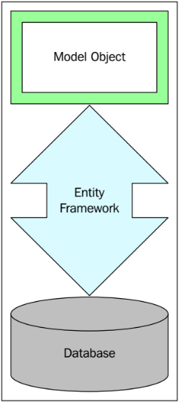
Figure 1-4

Slide 18
Is Entity Framework just another ORM?
The ADO.NET Entity Framework is an extended ORM technology from Microsoft.
We say it is an extended ORM because it has many additional features compared to a typical ORM.
ORMs often use metadata and factory classes to retrieve data or collections of data.
Factory classes are based on the factory design pattern and are used to create instances of classes without exposing the instantiation logic to the client.
On the contrary, using Entity Framework, you can easily map your data to be accessible in a relational representation in the database to objects, no matter how the mapping is implemented.
You can expose different data views to your application without having to change your relational schema.
In essence, this allows the applications to have their own view of the data.
The applications can even reuse the same views of data among themselves.
The major difference between Entity Framework and ORM tools is the EDM and the former's ability to query data using strongly typed LINQ.
You can even use Entity SQL, a T-SQL-like query language to query the EDM, to execute dynamic queries.

Slide 19
Is Entity Framework just another ORM? |
In addition to what a typical ORM framework provides, the Entity Framework provides and supports
entity inheritance
entity composition, and
a flexible, loosely-coupled, three-tiered model consisting of the
conceptual model
the mapping layer
the storage model
Entity Framework even enables you to extend the existing schema.
In other words, you can extend the generated entity classes to create your own custom entity classes.
You can define relationships of any kind such as
one-to-one
one-to-many
many-to-many

Slide 20
A comparative analysis of EF and other ORM tools
Data access strategies have changed over the years.
From Remote Data Objects (RDO), Data Access Objects (DAO), to ADO.NET, the industry has seen a marked improvement in the way data is accessed these days.
ORM tools enable you to access data from persistent storage devices without having to bother about how the underlying data is actually stored.
NHibernate is a lightweight ORM tool for .NET.
It has a statically compiled counterpart called Fluent NHibernate.
Fluent NHibernate provides you with an XML-less, compile safe, automated NHibernate mapper with LINQ support.
Domain modeling is an area where Entity Framework scores over NHibernate.
Consider the Listing 1-1 which shows an entity class.
The class in Listing 1-2 illustrates how you can create a mapping for the preceding class by extending the generic ClassMap<T> class.

Slide 21
A comparative analysis of EF and other ORM tools |
The code in Listing 1-3 illustrates how you can create a data gateway for the User entity class.
Note that you can make a call to DataManager.OpenSession( ) to open the database connectivity session.

Slide 22
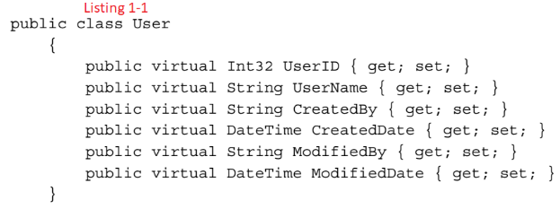
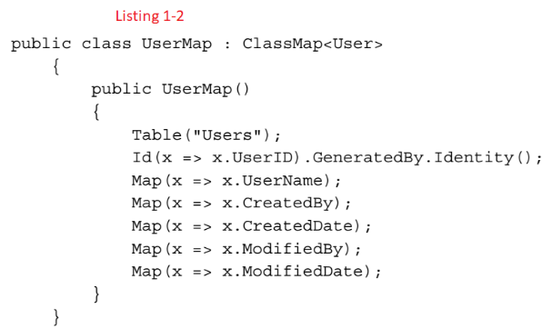
Listing 1-1 || 1-2

Slide 23
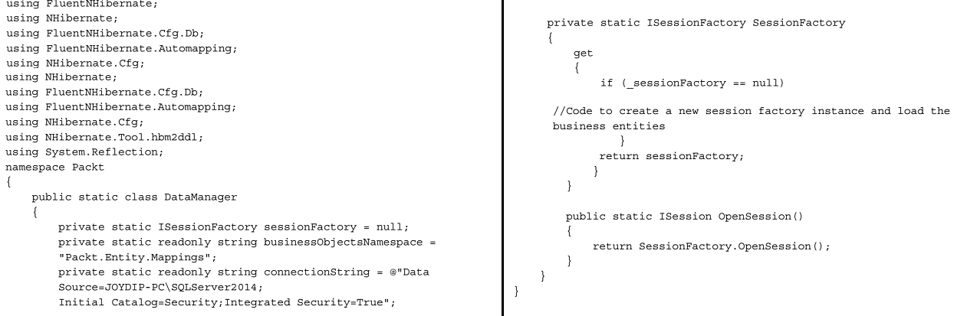
Listing 1-3

Slide 24
EF
Entity Framework 6 is a mature ORM and comes up with many powerful features.
When you use Entity Framework, you can concentrate more on writing application logic rather than writing the database connectivity code.
This reduces development time and effort greatly.

Slide 25
LINQ
Language Integrated Query (LINQ) is a query translation pipeline that you can use to integrate your queries into the object model.
LINQ provides you with a framework that you can use to access relational data in a strongly typed way.
LINQ provides a great way to query in-memory objects.
Here are the various forms that LINQ comes up with:
LINQ to objects: This is used to query in-memory objects or a collection of in-memory objects
LINQ to XML: This is used to query data retrieved from XML data sources
LINQ to SQL: This is used to query data retrieved from SQL Server database
LINQ to DataSet: This is used to query data from a DataSet or a DataTable
LINQ to Entities: This is used to query data exposed by the EDM

Slide 26
LINQ Library
The LINQ library contains two primary interfaces that all generic collection classes implement.
These are
the IEnumerable<T> interface
the IQueryable<T> interface
While the former exposes an enumerator to iterate over a collection of a given type T, the latter provides a functionality to query a data source that will implement this interface.
Also, IQueryable allows you to filter data on the server side.
The Figure 1-5 illustrates how these interfaces are related.

Slide 27
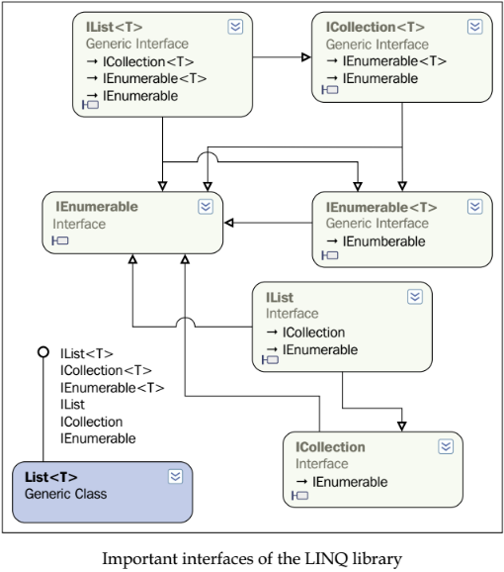
Figure 1-5

Slide 28
LINQ to SQL and .dbml files
LINQ to SQL allows you create an object model that maps to the tables in the relational database.
The ORM implementation of LINQ to SQL handles the execution strategy of the SQL queries.
A database markup language file, also known as .dbml file, is generated by the Visual Studio IDE when you drag and drop database tables from the solution explorer onto the LINQ to SQL design surface.
When each table is dragged on the design surface, a class is created for each table.
These classes are known as entity classes and they are partial classes.
Both LINQ to SQL and ORM share certain common behaviors in terms of designing, mapping entities with relational database, and querying entities.
Developing non-LINQ to SQL data-centric applications may consume a lot time and effort in trying to build custom components that will interact with the data source.
LINQ to SQL maps tables to classes, which helps architects to design a better n-tier architecture, thus improving productivity.
The properties in the entity classes are mapped to the columns in the table with an appropriate data type mapping scheme.
Hence, a compile time check is performed that reduces runtime errors.

Slide 29
Entity Framework architectural components
Entity Framework comprises the following components:
The Entity Data Model
LINQ to Entities
Entity Client
Entity SQL
The Object Services Layer
Note that the
Conceptual Model Layer
Mapping Layer
Logical Model Layer
are all parts of the EDM.
The Figure 1-6 illustrates the layers of the ADO.NET EF and how they are related to each other.
We will now discuss each of the components of the Entity Framework technology stack in the following sections.

Slide 30
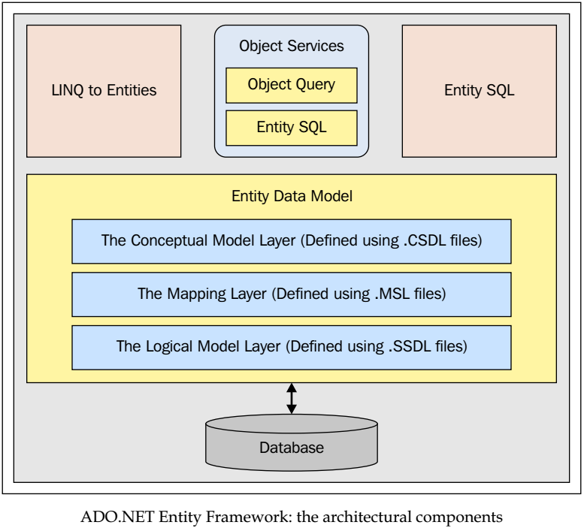
Figure 1-6

Slide 31
The Entity Data Model
The Entity Data Model (EDM), an extended entity relationship model, is the core of EF.
You can generate an EDM using the EDMGen.exe command-line tool or using the ADO.NET EDM Designer—a new Visual Studio template.
We will discuss how an EDM can be generated from a relational schema in the next chapter.
The Figure 1-7 illustrates where exactly the EDM fits in.
The EDM abstracts the logical or the relational schema and exposes the conceptual schema of the data using a three-layered approach.
It comprises the following layers:
The Conceptual Model Layer or the Conceptual Data Definition Language Layer (C-Space)
The Mapping Layer or the Mapping Schema Definition Language layer (C-S Space)
The Storage Layer or the Logical Layer or the Store Space Definition Language Layer (S-Space)
The Figure 1-8 illustrates the layers of the EDM.
Let's explain each of these layers in detail. Figure 1-9 shows a typical EDM.

Slide 32
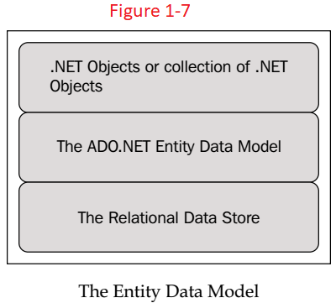
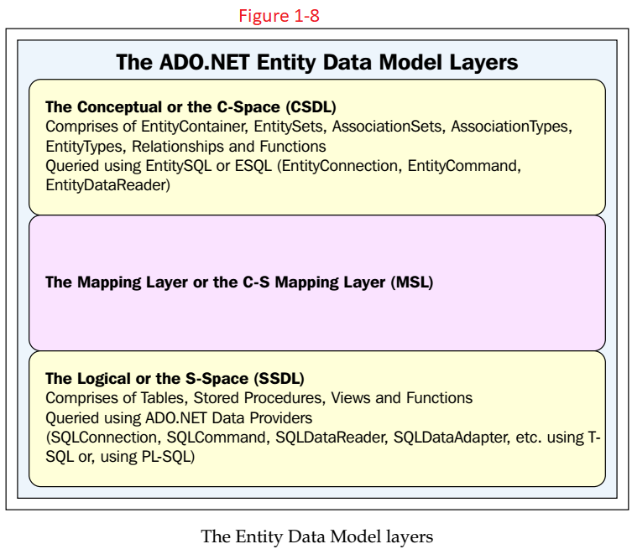
Figure 1-7 || 1-8

Slide 33
Conceptual Layer: C-Space Layer
The Conceptual Layer or the C-Space Layer is responsible for
defining the entities and
their relationships
It defines your business objects and their relationships in XML files.
The C-Space is modeled using CSDL and comprises of
EntityContainer
EntitySets
AssociationSets
AssociationTypes
EntityTypes
Functions
You can query this layer using Entity SQL or ESQL (EntityConnection, EntityCommand, and EntityDataReader).

Slide 34
The C-S Mapping Layer
The C-S Mapping Layer is responsible for mapping the conceptual and the logical layers.
That is, it maps the business objects and the relationships defined in the conceptual layer with the tables and relationships defined in the Logical layer.
It is a mapping system created in XML, which links or maps the conceptual and the Logical layers.
The C-S Mapping Layer is modeled using Mapping Storage Layer or the MSL.

Slide 35
Logical or Storage Layer: S-Space Layer
The Logical or the Storage Layer (also called the S-Space) represents the schema of the underlying database.
This comprises
Tables
stored procedures
Views
Functions
It is modeled using SSDL and queried using the database providers.
A database provider is an API to connect to and perform CRUD operations against a database.
As an example, if the database in use is SQL Server, the ADO.NET data provider for SQL Server will be used.
Hence, we use SQLConnection, SQLCommand, SQLDataReader, and SQLDataAdapter using T-SQL or PL-SQL if our data store is a SQL database.

Slide 36
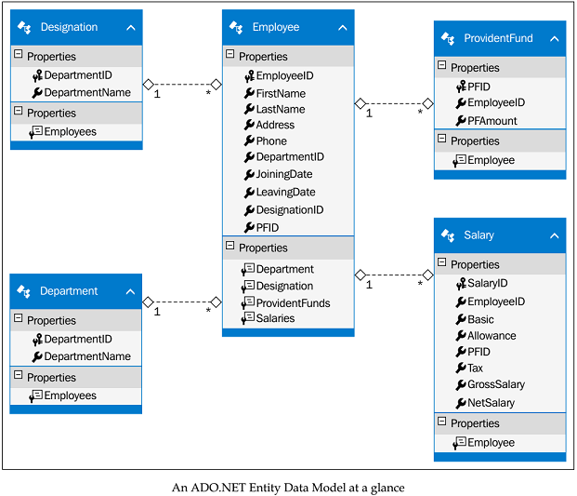
Figure 1-9

Slide 37
How is the EDM represented?
The EDM uses the following three types of XML files to represent the C-Space, C-S Space, and the S-Space respectively:
Conceptual Schema Definition Language (.CSDL): This represents the C Space and is used to map the entity types used in the conceptual model
Mapping Schema Language (.MSL): This represents the C-S Space and is used to map the logical model to the conceptual model
Store Schema Definition Language (.SSDL): This represents the S-Space and is used to map the schema information of the Logical layer
These files store the metadata information as XML for each of the preceding layers.
We will skip further discussion on each of the sections of an EDM until Chapter 3, Entities, Relationships, and the Entity Data Model.

Slide 38
Note
If you use the ADO.NET EDM Designer tool to generate your EDM, you will have one .edmx file that contains the CSDL, MSL, and SSDL sections bundled into one single file.
At runtime, the .csdl, .msl, and .ssdl files are created in the application's output directory.
You can also create
abstract types
complex types
in your EDM
You can derive from an abstract type to create sub-types, but no instance of the abstract type can be created.
You can also create complex types.
That is, types that don't have any identity of their own.
A typical example of a complex type is the Address type.

Slide 39
The Object Model (O-Space)
When working with Entity Framework, you will have an Object Model on top of all the EDM layers.
You need to model the Object Model using .NET objects.
The Figure 1-10 illustrates how the Object Model fits in with the EDM layers.
The Object Model layer contains a collection of .NET objects, types, properties, and methods.
You can use the Object Model or the O-Space Model to query your business objects, or the collections of your business objects, using LINQ to Entities or Entity SQL.
The C-Space and O-Space models are actually mapped by the O-C Mapping Layer using code attributes applied to the O-Space Model.

Slide 40
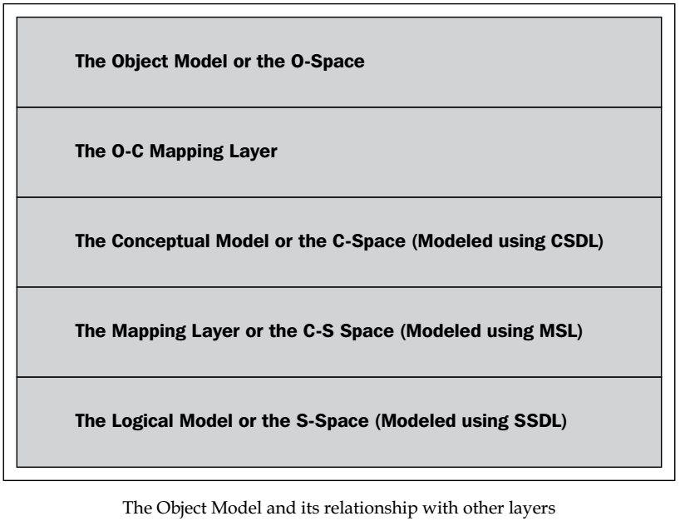
Figure 1-10

Slide 41
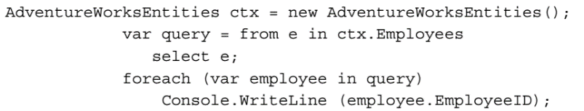
LINQ to Entities
LINQ is a query translation pipeline that has been introduced as part of the C# 3.0 library.
It comprises a set of query operators for different data sources (LDAP, objects, CSV, XML, entities, SQL, and so on).
It is an extension of the C# language (it's actually a series of extension methods) and provides a simplified framework to access relational data in a strongly typed, object-oriented manner.
LINQ to Entities is a Microsoft technology that enables you to query your business objects from within the language in a strongly typed manner.
You can use LINQ to Entities, a superset of LINQ to SQL, to query data against a conceptual data model, namely, the Entity Data Model.
You will learn more about LINQ and LINQ to Entities in Chapter 6, Working with LINQ to Entities.
Here is an example of a typical LINQ to Entities query:

Slide 42
Note
LINQ to Entities rests on top of Entity Framework's Object Services Layer and the LINQ to Entities queries are internally translated to canonical query trees.
This, in turn, gets converted internally to corresponding SQL queries in a form expected by your underlying database.

Slide 43
Entity Client
The Entity Framework allows you to write programs against the EDM and also add a level of abstraction on top of the relational model.
This isolation of the logical view of data from the Object Model is accomplished by expressing queries in terms of abstractions using an enhanced query language called Entity SQL.
EntityClient, the gateway to entity-level queries, is the Entity Framework's counterpart of ADO.NET's SQL client or Oracle client that uses Entity SQL or E-SQL to query the conceptual model.
You can
create a connection using the entity connection
execute commands through entity commands
retrieve the result sets as entity data readers
The MSDN states:
"The EntityClient provider is a data provider used by Entity Framework applications to access data described in a conceptual model."

Slide 44
Entity SQL
Entity SQL is a data store independent derivative of T-SQL that supports
Entity Inheritance
Relationships
You can use it to query data using the conceptual schema. You can even build your own dynamic queries.
These E-SQL queries are internally translated to data store dependent SQL queries.
This translation of the E-SQL queries to their data store-specific query language like T-SQL, (it doesn't need to be only T-SQL, however, it is the supported one), is handled by the Entity Framework.
Entity SQL or E-SQL may not be as strongly typed as LINQ is, but you have the flexibility of executing dynamic queries using it, much like T-SQL.
But, why do you need Entity SQL when you have LINQ to Entities to query data through your EDM?
You can, using Entity SQL, compose queries that are difficult to determine until the time the query is executed.

Slide 45
Entity SQL |
On a different note, Entity SQL is a full text-based query language that you can use in much the same way as you use the ADO.NET data providers.
Listing 1-4 shows an example that shows how you can use Entity SQL to insert data into your applications.

Slide 46
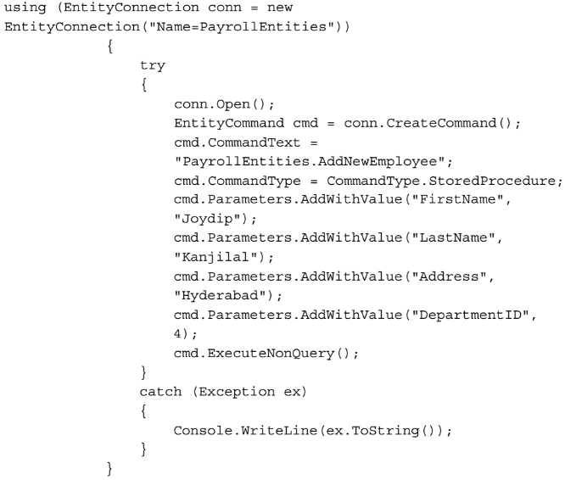
Listing 1-4

Slide 47
Note
Strongly typed data access is one of the most striking features of LINQ.
LINQ queries are checked at compile time.
This is unlike SQL queries, which are only detected at runtime.
To query data from the EDM, you have three choices
Entity SQL
LINQ to Entities
Object Services

Slide 48
Avoiding complex joins
You can use Entity SQL to avoid complex joins as you will be typically querying against a conceptual model of the data.
As an example, if we want to display employee names and the department names in which they work, we would have to join the information of the Employee and the Department tables and then filter the unwanted columns to retrieve only the information that is required.
Such traversals become a nightmare as you add additional tables and therefore require more complex joins.
When you implement your Object Model using object-oriented programming languages, you expose the object's relationships to other objects of its kind using properties.
This is in contrast to the approach we just discussed.
Hence, designing an Object Model using this approach is cumbersome.
This is exactly where Entity Framework fits in; it represents the conceptual and logical model of data while using grammar that is common to both.

Slide 49
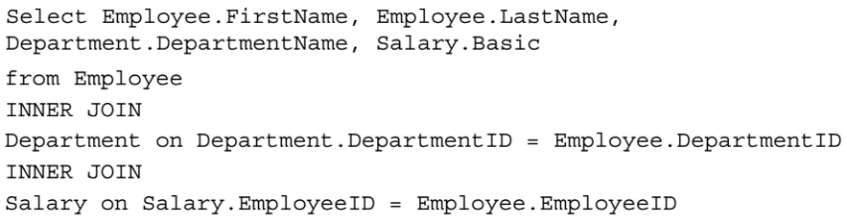
Avoiding complex joins |
Here is a code snippet that explains how you can use Entity SQL to avoid complex joins in your application's code.
The following code snippet shows T-SQL query can be used to retrieve employee data split across three tables, namely, Employee, Department, and Salary
This is how you would use Entity SQL to achieve the same result:
In the previous example, EmployeeData is an entity that has been derived from the Employee, Department, and Salary entities.

Slide 50
The Object Services Layer
As well as querying the conceptual model, you might, at some point, have to work with entities such as
In-memory objects or
A collection of in-memory objects
To do this, you need Object Services.
You can use it to query data from almost any data store, and with less code.
Note that the Object Services Layer internally uses an ObjectQuery object for query processing.
To use object services, you should include the
System.Data.Objects
System.Data.Objects.DataClasses
namespaces
Listing 1-6 shows an example on how to use Object Services to retrieve data.

Slide 51
Note
You can query data from the EDM by either using Object Services or EntityClient.
However, if you require change tracking, be aware that only Object Services provides this feature.
Note that in either case, the ADO.NET data providers are responsible for talking to the underlying database.

Slide 52
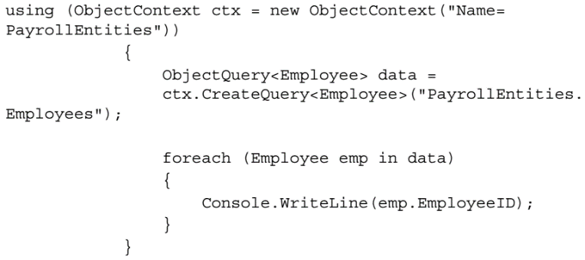
Listing 1-6

Slide 53
Services provided by Object service Layer
In addition to enabling you to perform create, read, update, and delete (CRUD) operations, the Object Services Layer provides the following additional services:
Change tracking
Lazy loading
Inheritance
Optimistic concurrency
Merging data
Identity resolution
Support for querying data using Entity SQL and LINQ to Entities
You will learn more about Object Services later in the book.
The Object Services Layer leverages an ObjectQuery object internally to process the data.
Note that the Object Services Layer supports querying data using both
Entity SQL
LINQ to Entities

Slide 54
Features and benefits at a glance
Here is a quick look at some of the features and benefits of Entity Framework:
It provides support for an increased level of abstraction on top of the underlying data store
It provides support for extensibility and seamless querying of data using
Entity SQL and
LINQ
It is a flexible schema that can be used to store the mapping information. There is a reduction in the amount of Kilo Lines of Code (KLOC) needed to write data access code in your applications
It contains a powerful Object Services Layer
It provides support for a full text-based query language
It provides support for persistence ignorance
It provides support for lazy loading
NOTE: KLOC refers to Kilo Lines of Code, a unit of measuring the amount of source code in your programs.

Slide 55
System requirements
To run the programs given in this book, you should have the following elements installed on your system:
Visual Studio.NET 2012 or higher
SQL Server 2014 or higher
Note that Entity Framework 6.0 already ships with Visual Studio 2013, so there is no need to download it if you use this version of Visual Studio.
Now let's take a quick look at each of these new features.
We will explore each of these features in detail as we move through the chapters.

Slide 56
Support for persistence ignorance
Support for persistence ignorance was introduced in Entity Framework 4.0.
Persistence ignorance, as the literal meaning implies, is a concept that enables you to build your applications in a way that can just ignore the underlying data store in use.
In essence, you can build applications that can have different persistent technology in future.
You can now create your own Plain Old CLR Objects (commonly known as POCO) that are decoupled from any specific persistence technology.
To provide support for POCO, all you need to do is just turn off code generation in the model in your Visual Studio 2013 IDE.
You can simply clear the values of the Custom Tool property of your EDM and save it again.
Once you have done this, you have to create your own custom object context by deriving your custom object context class from the ObjectContext class.
Then you can define the data members and properties in your custom object context class as per your needs.

Slide 57
Support for T4 code generation
T4 is a code generation technology that was introduced in Visual Studio 2008.
T4 templates not only give you advantage to customize the generated code, they also generate less code, concealing a lot of redundant functions that were present in the old generated code.
Entity Framework 6 provides support for T4 code-generation templates.
You can also customize these templates as needed.

Slide 58
Support for lazy loading
Lazy loading is a concept that enables an entity to be loaded late— it's loaded on demand actually.
Entity Framework 6 provides better support for lazy loading.
To enable deferred loading (it is turned off by default), you should make use of the DeferredLoadingEnabled property.
Please check out this URL for more information on lazy loading http://msdn.microsoft.com/en-us/library/vstudio/ dd456846(v=vs.100).aspx.

Slide 59
Note
Deferred loading works with both code-generated entities as well as your Plain Old CLR Objects—commonly known as POCO entities.
Some of the new features in EF6 such as enum support and spatial data types will work with .NET 4.5 and above.
The third-party providers for EF5 are not compatible with EF6.
This implies that if you are using the SQL Server or SQL Server Compact editions, you should update the database providers.

Slide 60
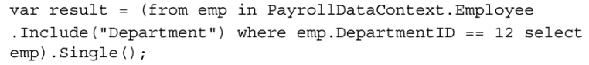
Support for POCO change tracking
Entity Framework 6 enables you to easily track changes to POCOs.
Note that Entity Framework 6.0 provides support for the deferred or lazy loading of entities with POCO classes through the usage of proxy types.
Here is an example:
We will explore more about POCO classes and lazy loading later in this book.

Slide 61
Better n-tier support with self-tracking entities
Entity Framework 6 provides better
n-tier support
support for self-tracking entities
Self-tracking entities are those that enable each entity to track any changes to themselves so that you can pass it across process boundaries and persist the entire object graph.
Entity Framework 6 includes T4 templates to generate entities that have the ability to track their own changes on the client side.

Slide 62
Support for code-first, model-first, and database-first approaches
Entity Framework 6 now enables you to generate your Data Model from the conceptual model.
You can now create your entities and then use Visual Studio 2013 to generate the database based on a predefined conceptual model.
In the code-first approach, the domain model is first defined using POCO classes and then the database is created from these classes.
This approach is popular and provides much more control over your code—you just need to define the database mappings and leave the creation of the database entirely to Entity Framework.
Note that as your code drives the database, manual changes to the database are not recommended in this approach.
The Figure 1-11 illustrates the three approaches and why and when each should be used.
In the model-first approach, you create your entities, relationships, and the inheritance hierarchies directly on the design surface of the EDM Designer in Visual Studio and then generate the database from the model designed.
If you need additional features, you can use partial classes.
In essence, in this approach, the model drives and defines the database.
This is also known as the model-driven approach.

Slide 63
Support for code-first, model-first, and database-first approaches |
This approach is good for small projects, but with complex databases and large projects this is not a preferred approach as you don't have much control over the database.
Also, making manual changes to the database schema is also not recommended.
In the database-first approach, you would create your database first and then generate your model using the ADO.NET EDM Designer from this database.

Slide 64
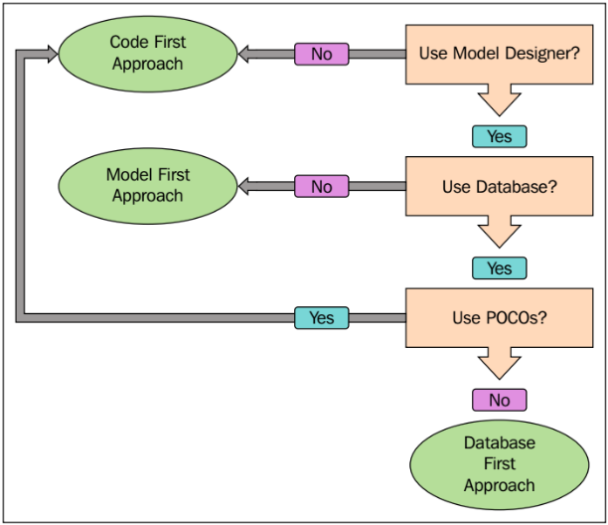
Figure 1-11

Slide 65
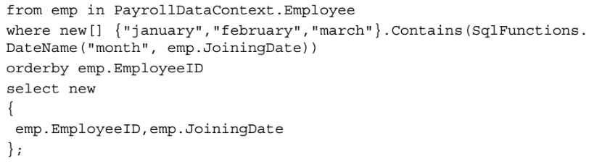
Support for built-in functions and UDF support
Entity Framework 6 provides support for you to use SQL Server functions directly in your queries.
Here is an example:

Slide 66
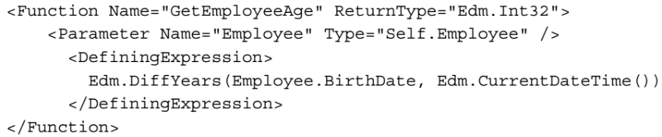
Support for model-defined functions
Entity Framework 6 now provides support for model-defined functions that can be defined in the CSDL using eSQL.
Note that model-defined functions support LINQ to Entities and can also be called Object methods.
Here is an example:
In this section, we just gave you an introduction to the new features in Entity Framework 6—we will cover details of each of these features in the forthcoming chapters of this book.

Slide 67
Enum support
Enum support is a much-awaited feature that enables you to have enum properties in your domain classes.
In Entity Framework 6, you have enum support both in the EF Designer as well as using a code-first approach.
To create an enum in Entity Framework 6, all you need is to create a scalar property of type Int32 in the EDM
select it
right-click on it and
then select Convert to Enum
The Figure 1-12 illustrates this.
In the preceding image, IsRetired has been introduced as a scalar property of type Int32.
You can see that the Convert to Enum option is enabled.

Slide 68
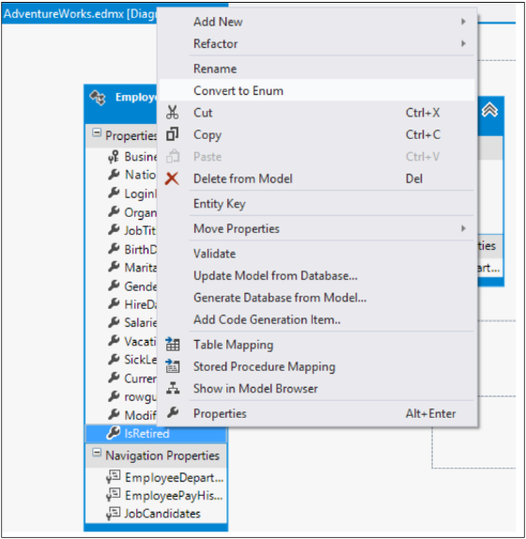
Figure 1-12

Slide 69
Spatial data types support
Spatial data types are actually geography and geometry-related classes that allow us to work directly with such data inside the SQL Server.
Spatial data can be of two types
the geometry data type that provides support for planar or Euclidean (flatearth) data, and
geography data type that can store ellipsoidal (round-earth) data such as GPS latitude and longitude coordinates.
Entity Framework 6 now provides support for spatial data types using the DbGeography and DbGeometry types.
You can include spatial data in your models both using the EF Designer, as well as using code-first.
You can find out more about spatial data types from this link: http://technet.microsoft.com/en-us/library/bb964711.aspx.

Slide 70
Other enhancements
In EF6, DbContext is the default generated context. It is not new though.
It is a wrapper around ObjectContext generated using T4 templates.
Listing 1-7 shows an example.
The other enhancements in Entity Framework are shown as follows:
Task-based asynchronous operation: This allows Entity Framework to take advantage of .NET 4.5 asynchronous support with asynchronous queries, updates, and so on.
EF6 now provides support for a simplified approach to asynchronous programming.
It can now be used to run async queries and also save data asynchronously.
Enhanced support for stored procedures and functions in code first: This feature allows you to map stored procedures and database functions by using the code-first APIs.
Support for custom code first conventions: This is a feature that allows you to write and register custom code conventions with code first.

Slide 71
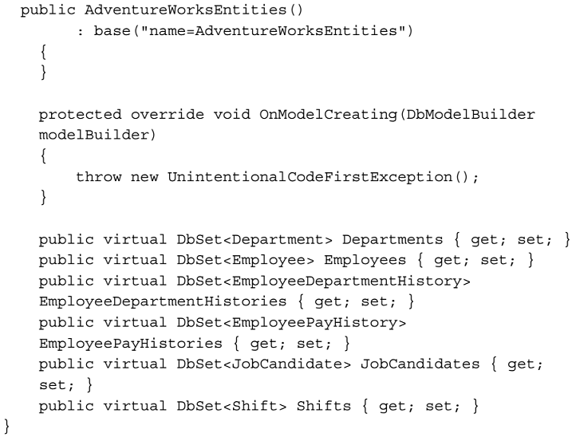
Listing 1-7

Slide 72
Performance improvements in EF6
In Entity Framework 6, query performance has been improved a lot.
One important performance improvement is in precompiled queries.
A compiled query is one that is stored as a parsed tree in memory so that it needn't be regenerated with every subsequent call.
You can create compiled queries in two ways:
creating an ObjectQuery class with EntitySQL and
also using the CompiledQuery.Compile function.
Compiling expression trees into SQL every time is an overhead particularly for queries that are complex.
This is exactly why compiled queries were introduced.
The earlier versions of Entity Framework contained the CompiledQuery class that you could use to precompile the query and then execute the query as and when needed.
So, in essence, when using precompiled queries, the SQL to be executed is figured out only once (during precompilation) and this is then reused each time the compiled query is executed.

Slide 73
Note
Note that if you are using CompiledQuery, you should make sure that you are using the query more than once.
This is because it is more costly than querying data the first time.

Slide 74
Auto-compiled Queries
Now, what were the downsides?
You cannot use CompiledQuery using the DbContext API as it only works with ObjectContext.
Note that the support for compiled query was revoked from the DbContext API due to some technical limitations.
If you use a code-first strategy, you will most likely be opting for the DbContext API.
Thankfully, Entity Framework 6 solved this problem, so you no longer need to make this choice.
With Entity Framework 6, you have a feature called auto-compiled queries—this works very different from the way CompiledQuery works.
You no longer need to write code to compile each query and then invoke as needed.
How does it work then? Entity Framework stores the generated SQL in the cache using a background thread and then as and when needed (based on the calls made), it searches the compiled queries in the cache.
This is illustrated in the Listing 1-8.
You can also turn off query caching if you need to.

Slide 75
Auto-compiled Queries |
The new ObjectContext.ContextOptions property allows you to control the default behavior of the query compilation.
This property is set to true by default, but you can set it to false to turn off the auto-compilation of your queries.
Here is an example:
If you are using DbContext, you should cast to IObjectContextAdapter, as shown in the following code:

Slide 76
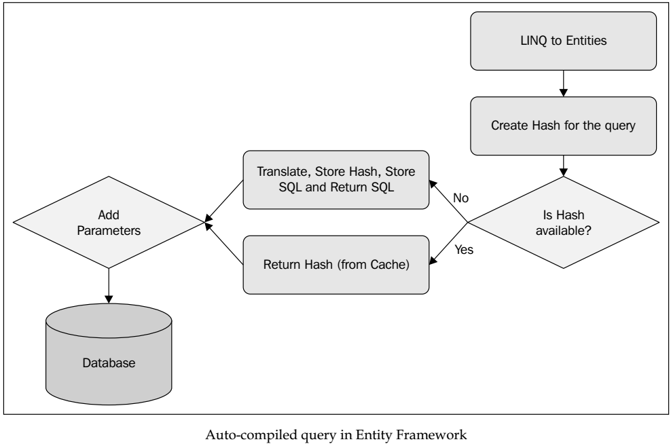
Listing 1-8

Slide 77
New features in Entity Framework 7
Entity Framework 7, a major redesign of the ORM, is the latest version of Entity Framework with the vision of "New Platforms, New Data Stores.“ Some of the striking features of this release include support for the following:
Non-relational data stores and in-memory data: You can now use Entity Framework with NoSQL databases as well.
Entity Framework 7 now provides support for the following data providers:
SQL Server SQLite
Azure Table Storage Redis
In memory (for unit testing)
Windows Phone and Windows Store applications and the Linux and Macintosh systems: EF7 now provides support for Windows Phone, Windows Store, and ASP.NET 5 and desktop applications.
Unit testing: EF7 now provides support to unit test your applications against in-memory or memory-resident databases.

Slide 78
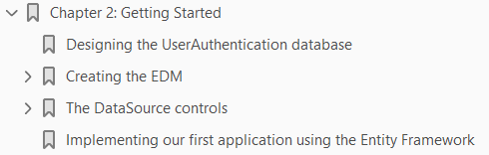
2
Getting Started

Slide 79
Intro
In the previous chapter, we took a look at Entity Framework, including its architecture and its features.
We also had a look at the new and enhanced features in Entity Framework 7.
Note that Entity Framework 6.0 ships with Visual Studio 2013, but you can also install it via NuGet if needed.
Also, Entity Framework 7 is yet to be released.
In this chapter, we will design our Security database, create an Entity Data Model (EDM) on top of it, and then use the EntityDataSource control to bind data exposed by the EDM to a GridView control.
The DataSource controls are those that are used to connect to a data source and then retrieve data from those data sources.
If you use DataSource controls, the need of writing tedious code to perform Create, Read, Update, Delete (CRUD) operations on data-based controls is eliminated.
The EntityDataSource control is a DataSource control that can connect to the data exposed by the EDM to perform CRUD operations.

Slide 80
Agenda
In this chapter, we will cover the following points:
Designing the UserAuthentication database
Creating an EDM for the UserAuthentication database
Introducing the EntityDataSource control
Implementing our first application using Entity Framework 6
The latest version of Entity Framework is Entity Framework 7.
As of this writing, Entity Framework 7 hasn't been released.
It will be released as a "pre-release" at the same time ASP.NET 5 is released. You will be able to install the pre-release version of EF 7 using NuGet.
There are many changes coming up in Entity Framework 7—it is being rewritten from the ground up.
The major goals of Entity Framework 7 include its support for new platforms and new data stores.

Slide 81
Agenda |
So, support for additional providers will also be included in Entity Framework 7 Figure 2-0.
We will start this chapter with a discussion on our UserAuthentication database that we will be using throughout this book, followed by a discussion on how we can create an EDM using the Security database.

Slide 82
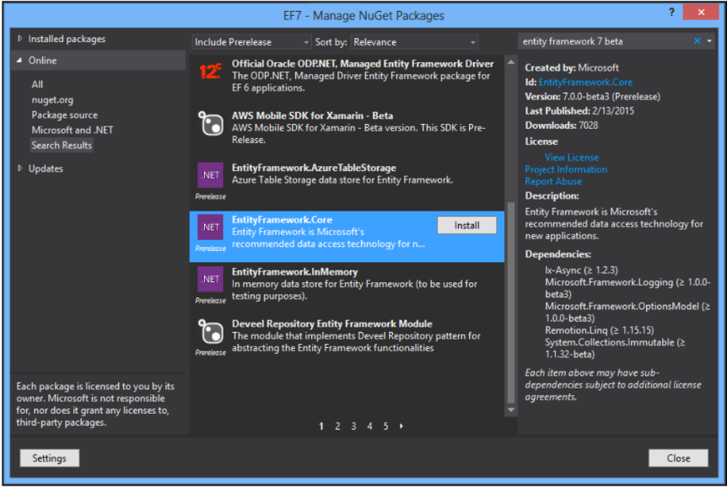
Figure 2-0

Slide 83
Designing the UserAuthentication database
Before we begin implementing a simple application that shows how data retrieved from the EDM can be consumed, let's take a quick look at the EDM again Figure 2-1.
As you can see in this diagram, our application needs to interact with the CSDL layer.
The SSDL layer will connect to the database (the Security database in our example), and the mapping layer will map these two layers so that they can communicate.
The Security database comprises of a list of the following tables.
Users: This table contains the user details.
UsersAuthentication: This table contains the user authentication details.
UserAuthenticationTypes: This table contains user authentication type data. User authentication type can be Windows, Forms, Passport, and Anonymous.
UsersLoginHistory: This table contains data related to user login history; ie. login history data of the user.
UserRoles: This table contains the user role details.

Slide 84
Designing the UserAuthentication database |
Roles: This table contains the role details.
Controls: This table contains an entry per control (note that each control is an object).
ControlTypes: This table contains the control type data.

Slide 85
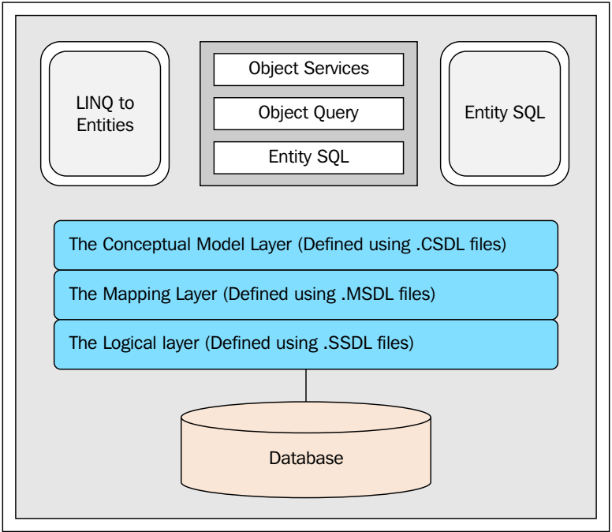
Figure 2-1

Slide 86
Creating the EDM
Now that the Security database is ready, we will explore how we can create an EDM on top of the Security database.
You can create the Entity Data Model in one of two ways:
Use the ADO.NET Entity Data Model Designer
Use the command-line Entity Data Model Designer called EdmGen.exe
The first approach is preferred to the second.
However, as we move through the chapters of the book, we will explore how we can follow the code-first approach to implement the model for our application that uses Entity Framework.
We will first take a look at how we can design an EDM using the ADO.NET Entity Data Model Designer.

Slide 87
Note
Prior to Entity Framework 7, there were two storage models
The EDMX file format based on XML schema or
Code
With Entity Framework 7, the EDMX file format will be dropped—we will have only the code-based format.
Interestingly, this approach is also termed the "code-first only" approach.

Slide 88
Creating the EDM using EDM Designer
To create an EDM using the ADO.NET Entity Data Model Designer, follow these simple steps:
Open Visual Studio.NET 2013 IDE, create a solution for a new web application project as follows, and save it with a name.
Switch to the Solution Explorer, and navigate to Add | New Item... to create a new Entity Data Model using Entity Data Model Wizard.
Next, select ADO.NET Entity Data Model from the list of templates displayed, as shown in Figure 2-2.
Name the Entity Data Model SecurityDB, and click on Add.
Select Generate from database from Entity Data Model Wizard, as shown in Figure 2-3.
You can also use the Empty model template to create the EDM yourself.
If you select the Empty model template and click on Next, the screen appears as shown in Figure 2-4.
As you can see from the previous screenshot, you can use this template to create the EDM yourself.
You can create the entity types and their relationships manually by dragging items from the toolbox. We will not use this template in our discussion here, so let's get to the next step.

Slide 89
Creating the EDM using EDM Designer |
Click on Next in the Entity Data Model Wizard window shown earlier (Figure 2-3).
The modal dialog box will now appear and prompt you to choose your connection.
Click on New Connection.
Now you will need to specify the connection properties and parameters for the database to connect to.
In our example, the database is Security.
After you specify the necessary user name, password, and server name, you can test your connection using the Test Connection button.
When you do so, the message Test connection succeeded gets displayed in the message box, as shown in the Figure 2-5.
Now, click on Next and specify the database objects you would like to have in your model from the Choose Your Database Objects and Settings window that is shown in Figure 2-6.
We will select all the tables of the Security database now. Refer to the Figure 2-7.

Slide 90
Creating the EDM using EDM Designer ||
Lastly, click on Finish to generate the EDM for the Security database.
Your EDM has been generated and saved in a file named SecurityDB.edmx.
We are done creating our first EDM using the ADO.NET Entity Data Model Designer tool.
When you open SecurityDB.edmx that we just created in the designer view, it is shown in Figure 2-8.

Slide 91
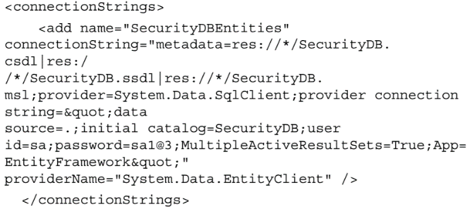
Note
We will use a dot to specify the database server name.
This implies that we will be using the database server of the localhost, which is the current system in use.
You can also specify the server name here if your database resides on a different system.
If your database resides on a different server, you need to specify the server name here.
The entity connection string is generated automatically.
This connection string will be saved in the ConnectionStrings section of your application's web.config file.
This is what it will look like:

Slide 92
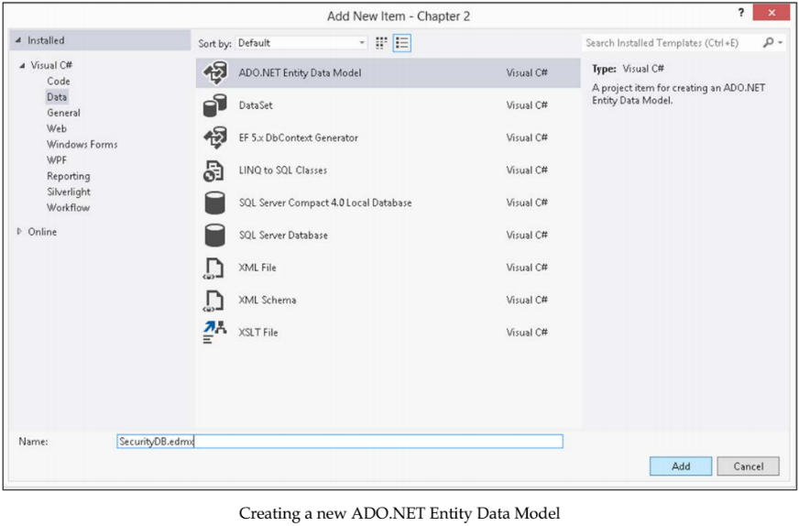
Figure 2-2

Slide 93
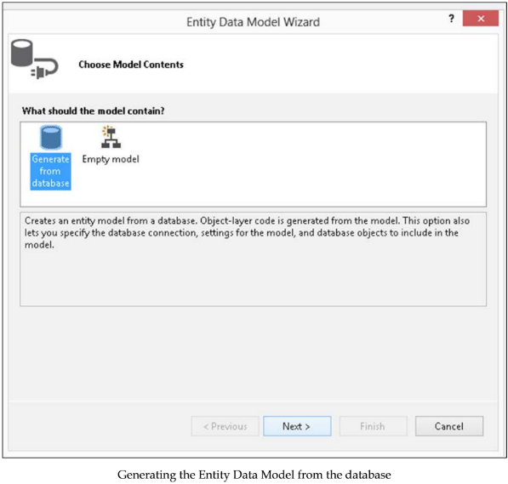
Figure 2-3

Slide 94
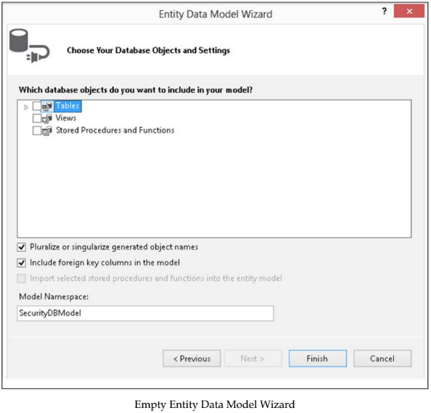
Figure 2-4

Slide 95
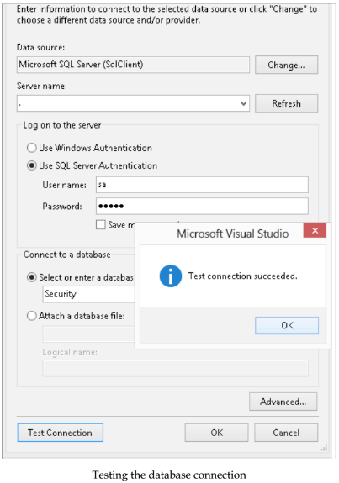
Figure 2-5

Slide 96
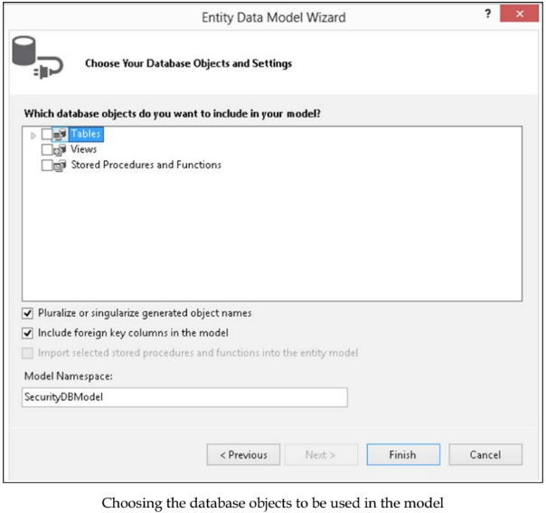
Figure 2-6

Slide 97
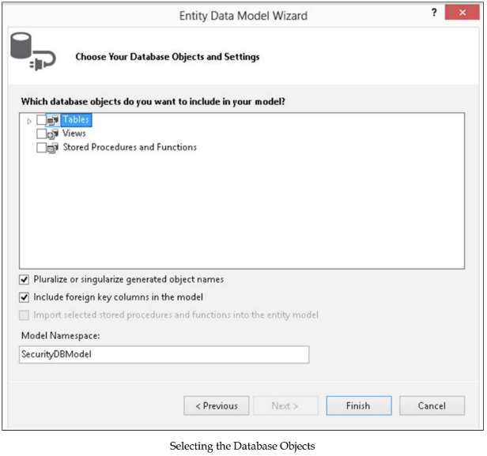
Figure 2-7

Slide 98
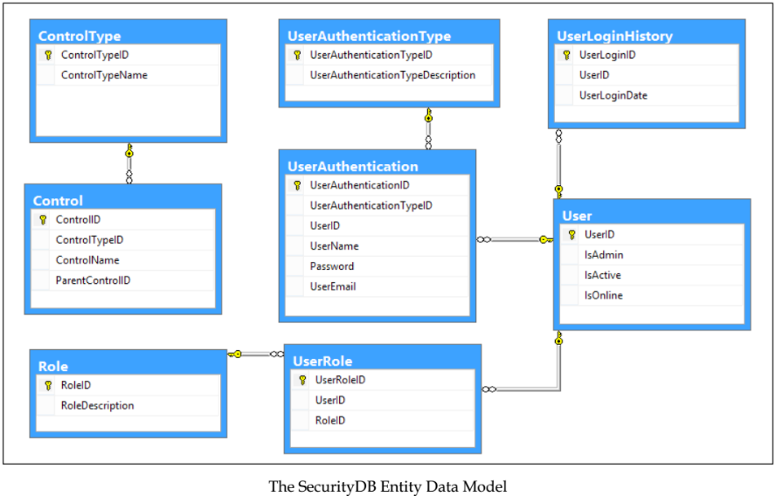
Figure 2-8

Slide 99
Creating the EDM using the EdmGen tool
We will now take a look at how to create a data model using the EDM generation tool called EdmGen.
The EdmGen.exe command-line tool can be used to do one or more of the following:
Generate the .cdsl, .msl, and .ssdl files as part of the EDM
Generate object classes from a .csdl file
Validate an EDM
The EdmGen.exe command-line tool generates the EDM as a set of three files: .csdl, .msl, and .ssdl.
If you have used the ADO.NET Entity Data Model Designer to generate your EDM, the .edmx file generated will contain the CSDL, MSL, and the SSDL sections.
You will have a single .edmx file that bundles all of these sections into it.
On the other hand, if you use the EdmGen.exe tool to generate the EDM, you will find three separate files with .csdl, .msl, or .ssdl extensions.
Table 2-1 lists the major options of the EdmGen.exe command-line tool.
Note that you need to pass the connection string, and specify the mode and the project name of the artifact files (the .csdl, .msl, and .ssdl files) to be created.

Slide 100
Creating the EDM using the EdmGen tool |
To create the EDM for our database, open a Visual Studio command window and type in the following:
This will create a full Entity Data Model for our database. The output is shown in the Figure 2-9.
You can also validate the SecurityDB model that was just created, using the ValidateArtifacts option of the EdmGen command-line tool, as follows:
When you execute the preceding command, the output will be similar to what is shown in the previous screenshot.
As you can see in the previous screenshot, there are no warnings or errors displayed. So, our EDM is perfect.
The section that follows discusses the DataSource controls included in ASP.NET and also the new EntityDataSource control, which was first introduced as part of the Visual Studio.NET 2008 SP1 release.
Note that the EntityDataSource control is included as part of Visual Studio 2010 and onward.

Slide 101
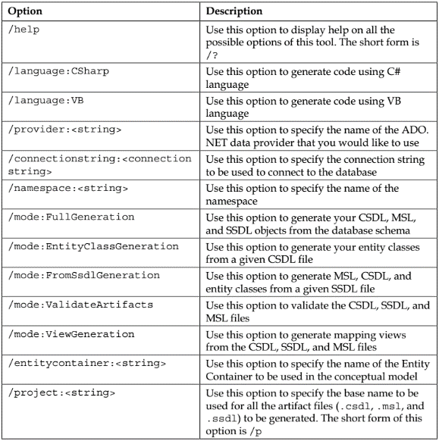
Table 2-1

Slide 102
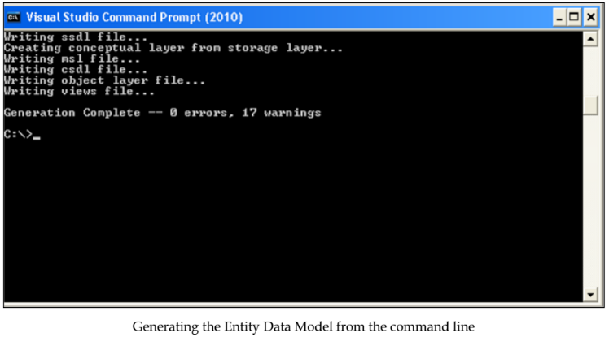
Figure 2-9

Slide 103
The DataSource controls
The DataSource controls are those that can be bound to data from external data sources.
These data sources may include databases, XML files, or even flat files.
ASP.NET 2.0 introduced some DataSource controls with a powerful data binding technique, so the need for writing lengthy code for binding data-to-data controls has been eliminated.
In ASP.NET, the term data binding implies binding the controls to data retrieved from a data source and providing read or write connectivity between these controls and the data that they are bound to.
A DataSource control acts like a layer in between your data source and the data bound control.
Data bound controls can be any control that actually interacts with the end user while consuming the data services provided by the DataSource control to which it is bound.
It defines certain methods and properties that perform data-specific operations like insert, delete, update, and select over the data exposed by the DataSource control while at the same time abstracting the data source.
In the sections that follow, we will discuss these controls with special emphasis on the EntityDataSource control.

Slide 104
The ObjectDataSource control
The ObjectDataSource control works with in-memory collections.
It defines properties like
InsertMethod
DeleteMethod
UpdateMethod
SelectMethod
which perform basic data storage and retrieval operations.
Appropriate methods must be created and mapped to the properties that perform the required task.
When one of these properties is used, the ObjectDataSource control actually creates an instance, invokes the appropriate method, and destroys as soon as it completes its execution phase.
ObjectDataSource are usually used in the business layer in your application, which helps you to directly bind to the data bound controls at the presentation layer.

Slide 105
The SqlDataSource control
The SqlDataSource control allows you to perform standard data operations, like insert, update, delete, and select on the data persisting in you relation database.
The SqlDataSource control is not meant only for the SQL Server database; it can work with any managed ADO.NET provider, which means that you can use the SqlDataSource control with different relational data sources.
The SqlDataSource control defines properties like InsertCommand, DeleteCommand, UpdateCommand, and SelectCommand, for performing standard data operations, like insert, delete, update, and select, over the data.
The command properties need appropriate queries to be set before using them.
When updates are performed on a data control that connects to a SqlDataSource control, the SqlDataSource control creates update parameters for all columns, even though few columns are updated.
The control also supports caching capabilities, which assist in improving the performance of the application.
For further reading on this topic, please refer to this link: http://msdn.microsoft.com/en-us/ library/system.web.ui.webcontrols.sqldatasource(v=vs.110).aspx.

Slide 106
The SiteMapDataSource control
The SiteMapDataSource control allows you to bind the site map of your website.
The site map can represent a hierarchical structure.
The SiteMapDataSource control needs an appropriate root node to be specified in a given hierarchy.
The SiteMapDataSource control contains properties that allow you to specify the node locations.
Primarily, the SiteMapDataSource control is used for the data navigation purpose, which means that you cannot perform standard data operations, like inserts, updates, deletes, sorting, and paging of the data.

Slide 107
The XMLDataSource control
The XmlDataSource control is another kind of DataSource control.
It basically represents the data, which is in the form of XML.
You can access the XML data from the XmlDataSource control by connecting to a XML file or to XML data embedded as a string within the DataSource control.
Caching in the XmlDataSource control is enabled by default for increasing the performance.
You can perform standard data operations like insert, delete, update, and select over the XML data that is represented by the XmlDataSource control.
However, operations like sorting and paging are not supported by the XmlDataSource control.
The control also provides support for applying XML transformations through a XML style sheet.

Slide 108
The LinqDataSource control
The LinqDataSource control is a new control that has been introduced in ASP.NET 3.5.
It extends the DataSource control and resides in the System.Web.UI.WebControls namespace.
It provides a new approach for binding LINQ models to web controls in your ASP.NET applications.
The LinqDataSource control provides properties and events, using which you can perform operations like selecting, filtering, grouping, and ordering against LinqDataSource.
The LinqDataSource data control provides a flexible mechanism to build a data control with wizard-based workflow.
It allows you to perform CRUD operations on the data over a LINQ model with minimal need to write SQL queries.

Slide 109
The EntityDataSource control
The EntityDataSource control is an example of a data control that was first included as part of the Visual Studio 2008 SP1 release, and can be used to bind data retrieved from an EDM to the data bound controls of ASP.NET.
For further reading on this topic, please refer to this link: http://blogs.msdn. com/b/webdev/archive/2014/01/30/announcing-preview-of-dynamic-dataprovider-and-entitydatasource-control-for-entity-framework-6.aspx.

Slide 110
Implementing our first application using the EF
In this section, we will learn how to use the EDM and the EntityDataSource control to implement our first program using the Entity Framework.
We will use a GridView control to display bound data.
Let's first have the environment ready. I will run you through the steps to download and install Entity Framework 6 now.
In the Solution Explorer, right-click on the project and select EntityFramework from the list of NuGet packages, as shown in the Figure 2-10.
Click on Install to start downloading and installing Entity Framework 6.
Once Entity Framework 6 has been downloaded, click on Accept to start the installation.
After Entity Framework 6 has been successfully installed and the necessary changes applied to your project, you are ready to start writing your first application that makes use of this framework.

Slide 111
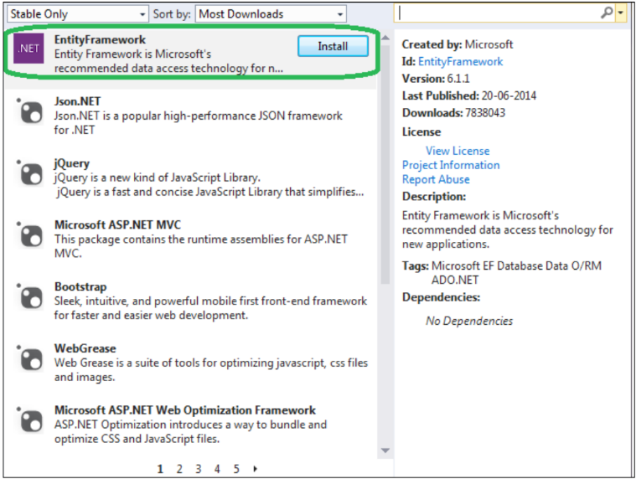
Figure 2-10

Slide 112
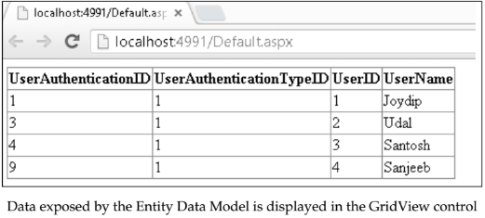
Steps Involved
Refer to the solution we created earlier using the Entity Data Model Designer. Now follow these steps:
Drag and drop an EntityDataSource control from the toolbox onto Default.aspx web form –Figure 2-11.
Now click on the Configure Data Source... option to specify the data source. Refer to the Figure 2-12.
Specify the ConnectionString and DefaultContainerName fields, and then click on Next – Figure 2-13.
Specify the fields you want to retrieve from the database table, and click on Finish when done - Figure 2-14.
Now drag and drop a GridView control from the toolbox onto the Default.aspx web form.
Next, use the Choose Data Source option of the GridView control to associate its data source with the EntityDataSource control we created earlier – Figure 2-15.
When you execute the application, your output should be similar to what is shown in the following image:

Slide 113
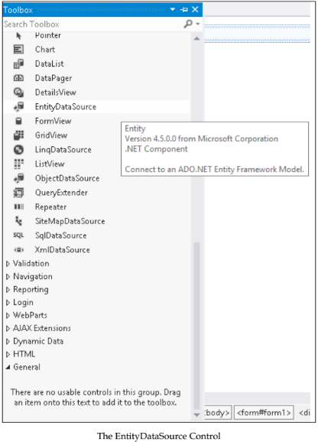
Figure 2-11

Slide 114
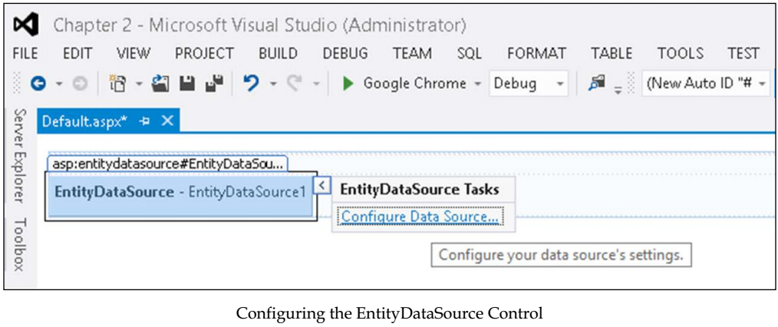
Figure 2-12

Slide 115
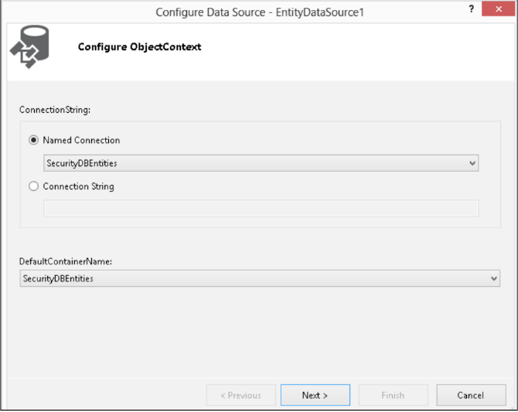
Figure 2-13

Slide 116
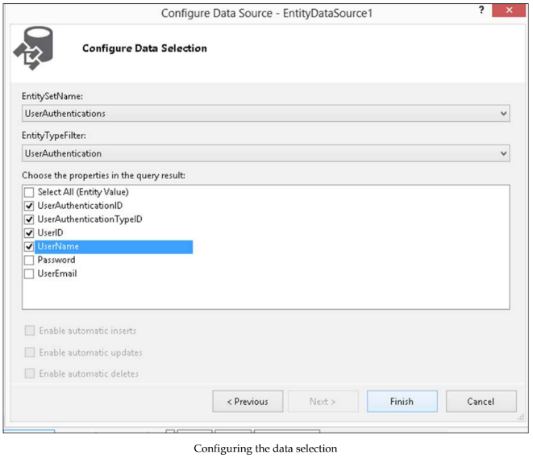
Figure 2-14

Slide 117
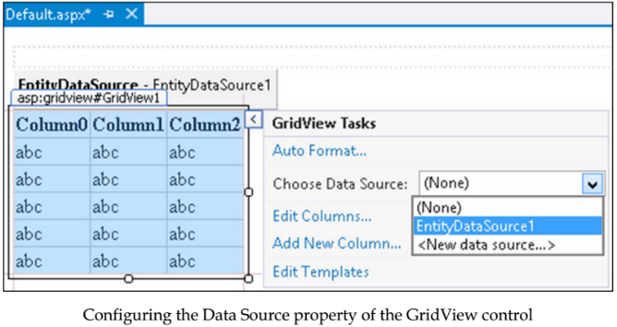
Figure 2-15

Slide 118
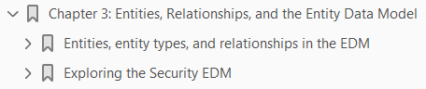
3
Entities, Relationships, and the Entity Data Model

Slide 119
Intro
In the last chapter, you learned how we can get started using Entity Framework.
As I mentioned in the earlier chapter, Entity Framework 7 is not yet released at the time of writing.
So, we will discuss Entity Framework 6.x in this book and highlight the features of Entity Framework 7 wherever applicable.
In this chapter, you will learn about the Entity Data Model and its components.
The EDM is a conceptual model that can be used to design the data access layer of your application.
We will revisit the Security EDM we created in the previous chapter and discuss each of the sections.
Specifically, we will discuss the following points:
Entities, entity types, and relationships
Introducing the Entity Data Model (EDM)
The goals of EDM
CSDL, MSL, and SSDL

Slide 120
Intro |
Customizing entities
Customizing the EDM
Exception handling with Entity Framework
In this chapter, we will discuss each of the sections of the EDM in detail.
We will start our discussion with our understanding of entities and their relationships.
We will then move ahead and discuss how they are mapped in the EDM using XML.

Slide 121
Entities, entity types, and relationships in EDM
The EDM is an implementation of the Entity-Relationship model (commonly called the E-R model). It depicts entities and their relationships.
The EDM is a view of the data store that your application will use – Figure 3-1.
Before we explore deeper into our Security DataModel, let's discuss entities, entity types, relationships, and how these are all represented.

Slide 122
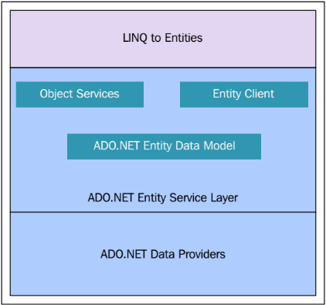
Figure 3-1

Slide 123
What is an entity?
An entity essentially models individual, real-world objects such as employees and customers.
Such objects contain information pertaining to the entity.
An entity is something that is uniquely definable, distinctly identifiable, and can have one or more of the following properties:
It should be identifiable easily through the data that it holds
It should have properties that can hold scalar values that represent the entity's data
It should only contain data, not methods or operations on the data
It can have entity relationship information such as how one entity is related to another
An entity refers to an instance of an EntityType, such as an employee, a customer, or a product.
The type of an entity is defined using an EntityType.
An EntityType is used to represent a particular type of data in the conceptual model—an employee, a customer, order, or anything that is relevant to an application.

Slide 124
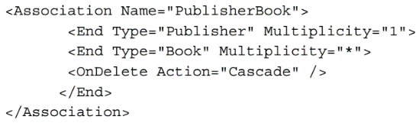
What is an entity? |
As an example, an employee belongs to a particular department, a product belongs to a particular group, a customer buys a particular product, and so on.
Each and every EntityType is uniquely identified by a unique key also called the EntityKey.
Any two entities can be related to each other using relationships.
These relationships are actually instances of Relationship Types.
Such relationships can either be
An Association
Containment
The following code snippet illustrates how this is defined in the EDM:

Slide 125
Note
The names of the nodes in the EDM, such as EntityKey and EntityType, should not have any space in the middle.
This is the convention for the XML syntax used in EDM.

Slide 126
Defining entity sets in the EDM
An EntitySet may be defined as a logical group of similar entities.
In other words, all the entities
contained within an EntitySet are of the same or
derived from the same EntityType
Figure 3-2 shows how an EntitySet attribute is defined in the EDM.
Note that the EntityType for the EntitySets are defined using the EntityType attribute.
Fine, but what does an EntityType attribute contain? An EntityType attribute consists of one or more properties and a key.
These properties can be nonnullable, which implies that they are mandatory fields in the database.
Figure 3-3 shows how the EntityType attributes are defined in the EDM. Figure 3-4 shows how the EntityType user is defined. Figure 3-5 shows how the EntityType UserAuthentication is defined.
Figure 3-6 shows how the EntityType UserAuthenticationType is defined.
The UserLoginHistory table in the Security database stores the login history of the users who have logged in to the system – Figure 3-7.

Slide 127
Defining entity sets in the EDM |
The UserRole entity defines the roles for each user – Figure 3-8.
Note how the Name attribute and the Key element of the EntityType are defined.
The property names of the entity are defined using the Property elements.
Each of these properties has specified types such as Integer or String types
The Nullable attribute is used to denote whether or not the property can accept null values.
It is a Boolean attribute and accepts either a true or false value.
NavigationProperty is one that defines the end points of a relationship.
If you look at the preceding code snippet that illustrates the UserRole EntityType, you will find a navigation property called User.

Slide 128
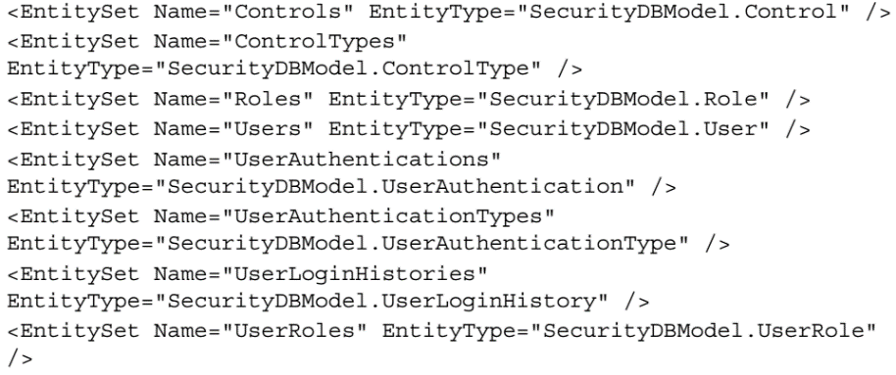
Figure 3-2

Slide 129

Figure 3-3

Slide 130

Figure 3-3 |

Slide 131

Figure 3-4

Slide 132

Figure 3-5

Slide 133

Figure 3-6

Slide 134

Figure 3-7

Slide 135

Figure 3-8

Slide 136
Extending existing entity types - derived entity types
The EDM allows you to derive (inherit) a type from a base type.
The derived type extends an existing entity type to add additional information specific to the type.
The EDM also allows you to specify multiple derived types, also called sub types, from a common base type.
Note that entity types may have scalar, complex, and navigation properties.
Properties are the fundamental building blocks of entity types and complex types in Entity Framework.
A scalar property is one whose actual value is contained in the entity.
As an example, the entity Employee contains scalar properties such as EmployeeId, FirstName, LastName, and so on.
Navigation properties are used to navigate from one entity to another—this is similar to foreign key relationships in your database.
As an example, the entity Employee can be mapped to the entity Department.
A complex type is a non-scalar property that allows you to group related properties.
As an example, Address is a complex property.

Slide 137

Derived Type Example
Let's start with an example.
Both Employee and Customer can derive from the base type called Person.
These sub types then in turn become the base types for other entities.
So, the Employee type can in turn be the base type for Manager, and so on.
Here is how you can extend an existing EntityType to specify your own derived EntityType:

Slide 138
Inheritance
In the EDM, you can specify inheritance in three ways:
Table-per-Hierarchy Model (TPH): In the TPH, the base types and the derived types are all specified using the same database table.
Table-per-Type Model (TPT): In the TPT, the base type is in one table while the derived types are spread across other tables.
Table-per-Concrete Class (TPC): In the TPC type of inheritance, each derived entity is mapped to a particular physical database table.
In essence, data for the entity is stored in a separate table.
Consider the POCO classes in Figure 3-9.
The mappings are shown in Figure 3-10.

Slide 139


Figure 3-9 || 3-10

Slide 140
Association sets, associations, containment, and multiplicity
A relationship represents the logical connection between two or more entities.
The EDM supports both unary and binary relationships.
The association type of relationship models the peer to peer connection between entities.
In other words, it links two or more entities.
It has a name and some elements that define the endpoints of the association.
The Figure 3-11 illustrates how a Batch entity and a Student entity are related—one batch can have one or more students.
An AssociationSet attribute is a set of associations.
In essence, it may be defined as a logical container of one or more associations of the same type.
An association defines the relationship between entity types.
While an association and an entity represent the types, an AssociationSet attribute and an EntitySet attribute represent the storage location of those types.

Slide 141
Association sets, associations, containment, and multiplicity |
It is to be noted that Association and AssociationSet attributes act as building blocks to the pre-runtime library that is created.
Here is how AssociationSet is defined in the EDM – Figure 3-12.

Slide 142


Figure 3-11 || 3-12

Slide 143

Containment
Containment is a type of bidirectional relationship with the multiplicity as 1 to 0..N.
A containment relation can be used to represent inheritance between entities.
Here is an example of how a containment relationship is defined in the EDM.
A parent can have one or more or zero children:

Slide 144

Multiplicity
Multiplicity is used to define the number of entity instances that are related to the other.
Based on multiplicity, relationships between entities can be one of the following:
One-to-one
One-to-many
Many-to-many
The figure given next illustrates how multiplicity is defined:
The Multiplicity attribute as shown in the preceding code snippet, is used to define one-to-one, one-to-many, or many-to-many relations among the entities.

Slide 145
What are entity containers?
An entity set is defined as a logical container for entities of a particular type and its subtypes.
All EntitySets and AssociationSets are defined within the context of the entity container, which is a logical grouping of EntitySets and RelationshipSets.
Here is an example of how an EntityContainer attribute is defined in the EDM – Figure 3-13.
In the next section, we will revisit the Security EDM and take a look at its components (the CSDL, MSL, and SSDL sections).

Slide 146

Figure 3-13

Slide 147
Exploring the Security EDM
The EDM allows the application to have its own view of the application's data.
Consider the following EDM created using the Visual Studio 2015 ADO.NET EDM Wizard – Figure 3-14.
Note that the relationships and the respective fields are displayed along with their multiplicity.
You can also see the scalar and navigation properties.
While the Scalar Properties section lists the attributes or the fields of the entity
the Navigation Properties are those that denote the associations of a particular entity with other entities
As an example, the UserRole entity uses the User and the Role entities to relate its foreign keys UserID and RoleID respectively.
This is also called a join table and facilitates a many-to-many relationship.

Slide 148

Figure 3-14

Slide 149

The Mapping Details window
Now we will take a look at the mappings details.
That is, how the properties of the entities are mapped to the underlying database.
To do this, select any entity in the Security DataModel in the design view, right-click on it, and then click on the Show in Model Browser option, as shown in the following Figure 3-15.
This opens the Model Browser window.
This is what the mapping details of the UserAuthentication entity looks like:

Slide 150

Figure 3-15

Slide 151
The Entity Model Browser
The Entity Model browser shows the conceptual and storage models of your EDM in a diagram view.
When you open an EDM in the Model Browser window, you can see the following:
The Conceptual Model
Entity types
Associations
An Entity container
Entity sets
Association sets
Function imports
The Storage Model
Tables
Views

Slide 152
The Entity Model Browser |
Stored procedures
Constraints
This is what the Security DataModel looks like when opened in the Model Browser window – Figure 3-16.
As you can see from the preceding figure, we have the EDM and its entity types, the associations, and also the store where we have our database tables, views, stored procedures, and constraints.

Slide 153

Figure 3-16

Slide 154
The EDM layers
To see the EDM layers, you can right-click on the .edmx file in the solution explorer and open it in XML editor.
Now, when you open our Security DataModel file in its XML view, you can see three major sections including:
The Conceptual Model (CSDL)
The Storage Model (SSDL)
The Mapping Layer (MSL)
In the sections that follow, we will take a look at each of these sections of our Security DataModel.

Slide 155
The CSDL schema
The EDM uses the Conceptual Schema Definition Language (CSDL) to define entities and their relationships.
Note that this CSDL schema is generated when the .edmx file is created.
The CSDL Schema defines a namespace and an alias that can be used for referencing.
The CSDL content comprises mainly of:
An entity container
A collection of EntityTypes
A collection of associations
The CSDL schema is organized as a collection of EntitySets, AssociationSets, EntityTypes, and AssociationTypes as shown in Figure 3-17.
We have an EntityContainer attribute called SecurityDBModelStoreContainer, a collection of EntitySets including Control, ControlType, Role, User, UserAuthentication, UserAuthenticationType, UserLoginHistory, and UserRole.

Slide 156
The CSDL schema |
We also have a collection of EntityType attributes with their properties and navigation properties defined. An entity type is defined as a logical specification for a data type that includes a key and a named set of properties.
Next we have several associations and AssociationSet elements that comprise a set of association definitions with each association depicting a foreign key relation.
Note that the End Role attribute of the AssociationSet element defines the end point of the foreign key relation.
The AssociationSet attribute called FK_UserRole_Role defines a foreign key relation between the User and UserRole entities.
In the next section, we will take a look at the SSDL section in the Security DataModel.

Slide 157

Figure 3-17

Slide 158
The SSDL schema
The schema definition for the Store Schema Definition Language or SSDL (automatically generated by Visual Studio when the .edmx file is created) section is similar to its CSDL counterpart.
In addition to what we have just seen in the CSDL schema, we have field types, field lengths, and identity properties that specify whether a particular column in the database table is an identity column.
The SSDL schema is also organized much the same as CSDL with the relational schema information of the database in use.
Here is how the entities are represented in SSDL – Figure 3-18.

Slide 159

Figure 3-18

Slide 160
The MSL schema
We will now take a look at the Mapping Specification Language or MSL schema (automatically generated by Visual Studio when the .edmx file is produced) that defines the C-S mapping, which maps the Conceptual Model to the Relational Store.
Here is the MSL schema for our Security DataModel – Figure 3-19.
As you can see in the MSL schema just mentioned, the EntityContainerMapping attribute is used to indicate that the StorageEntityContainer attribute is mapped to the conceptual model container.
But how is this mapping achieved? Entity Framework does this by mapping each EntitySet and AssociationSet attributes to the corresponding elements in the data store.
As an example, it uses the StoreEntitySet attribute to map a particular EntityType to the corresponding database table.
There are also many ScalarProperty attributes that define how a particular property is mapped to its corresponding column name in the database table.
The EntityTypeMapping attribute is used to specify the type of the entity being represented.
The MSL schema maps the CSDL and SSDL sections of the EDM.

Slide 161

Figure 3-19

Slide 162
Entity Classes
These are .NET classes that are automatically generated from the CSDL definition.
You can create POCO classes from .edmx files using Entity Framework DbContext Fluent Generator.
When you do this, T4 templates will be automatically added to your project.
You can download the DbContext Fluent Generator from https:// visualstudiogallery.msdn.microsoft.com/5d663b99-ed3b-481d-b7bcb947d2457e3c.
These are similar to business entities and can be used to populate data and pass instances of these classes across the layers of the application.
Note that whenever the CSDL definition changes, these classes are automatically updated to reflect the changes.
Also, these classes are partial classes and hence you can extend them to create your own custom classes too.
These are also partial because you want to keep your extensions in a separate file so they are not overridden if the class is regenerated—this facilitates extensibility and also convenience.
The Figure 3-20 shows what the Control and ControlType entity classes look like:

Slide 163
Entity Classes |
Note the use of the virtual keyword in the ControlType class. This is used to promote lazy loading.
The virtual keyword is used to facilitate lazy loading—if the virtual keyword is not there, the property would be eager loaded.
The usage of the virtual keyword also helps in efficient change tracking.
The Role and User entity classes are shown in Figure 3-21.
Note the use of HashSet in the User class.
HashSet is used to ensure that the collection contains one instance (no duplicates) of an instance.

Slide 164


Figure 3-20 || 3-21

Slide 165

4
Working with Stored Procedures in the Entity Data Model

Slide 166
Intro
The Entity Framework is an extended Object Relational Mapping (ORM) technology from Microsoft that abstracts the object model of an application from its relational or logical model.
The newer versions of this framework provide you with many exciting features—model-first development being one of these things.
In this chapter, we will explore how we can work with stored procedures in Entity Framework 6.
We will discuss the following points:
Creating a database using model-first development
Creating stored procedures for the database
Mapping stored procedures to functions in the EDM
Using the stored procedures in the Object Layer
Mapping stored procedures that return custom entity types
Adding stored procedures to the EDM
Mapping stored procedures that return custom entity types

Slide 167

Note
Note that as of this writing, support for stored procedures is not yet included in Entity Framework 7.
However, you can do it using plain ADO.NET statements, as shown in the code snippet that follows:

Slide 168
Creating a database using model-first development
One of the most interesting new features and enhancements introduced in Entity Framework 6 is its ability to generate a database from an existing object model.
This approach provides you with better control over your design and promotes domain-driven design (DDD).
In this approach, you can design your domain model based on the business requirements first and then generate the database from it.
Before we explore this further, let's take a quick tour of the modeling approaches that are supported.
The domain modeling approaches in Entity Framework include the following:
Code-first Model-first Database-first
Microsoft has planned to retire the Visual Design tool for the EF 7 (EF Core 1.0) of the framework.
As a result, you will only have the code-first approach to build your entity classes.
This is also known as the code-first only approach.
In this section, we will explore how we can make use of Entity Framework to create a database using Visual Studio 2015 and Entity Framework.

Slide 169
Domain Modeling Approaches
The domain modeling approaches in Entity Framework include the following:
Code-first: In this approach, the domain model is first defined using the POCO classes and then the database is created from these classes.
This approach is popular and provides much more control over your code—you just need to define the database mappings and leave the creating of the database entirely to Entity Framework. Note that as your code drives the database, manual changes to the database are not preferred in this approach.
Model-first: In the model-first approach you create your entities, relationships, and the inheritance hierarchies directly on the design surface of the EDM Designer in Visual Studio, and then generate the database from the model designed.
If you need additional features, you can use partial classes. In essence, in this approach, the model drives and defines the database. This is also known as a model-driven approach.
This approach is good for small projects, but with complex databases and large projects, this is not a preferred approach as you don't have much control over the database and making manual changes to the database schema is also not preferred.

Slide 170
Domain Modeling Approaches |
Database-first: In this approach, the database is first designed and then the model is generated from the database. In this approach, you can make manual changes to the database and then regenerate the model from the database.

Slide 171
Model-first Approach
Follow these steps:
Open Visual Studio 2015, create a blank new ASP.NET project, and save it with a name.
Right-click on the project created in the Solution Explorer window and select Add | New Item...,.
Select ADO.NET Entity Data Model from the list of the templates displayed and provide the name, Payroll.
Then, click on Add:
On the Entity Data Model Wizard screen that is displayed next, select Empty model since we will be generating our database from the model - Figure 4-1.
Click on Finish. The Payroll.edmx file will be created and added to the project.
The EDM we just created looks like the Figure 4-2.
The next step is to create entities and associations. To do this, follow these steps:
Right-click on the Entity Data Model Designer and navigate to Add New | Entity... from the pop-up menu displayed in Figure 4-3.
Provide the name of the entity as Employee and specify the key property name as EmployeeID, as shown in Figure 4-4.

Slide 172
Model-first Approach |
The next step is to create the properties for the entity we just created.
To create a scalar property for the Employee entity, right-click on the entity in the Entity Data Model Designer and navigate to Add New | Scalar Property Figure 4-5.
Specify the name, length, and type of the scalar property.
Repeat the same for all the properties you need for the Employee entity.
Now, create the Department entity and its properties by using the same procedure you followed for the Employee entity.
So, we have two entities, namely Employee and Department, created. The next step is to associate these entities.
To create an association between the entities, select the Department entity in the designer and navigate to Add | Association.
The Add Association dialog appears as shown in the Figure 4-6.
You can specify the variations in the association by using the multiplicity drop-down controls, as shown in the preceding screenshot.

Slide 173
Model-first Approach ||
In this example, we will go ahead with the default association. So, click on OK to save the association.
The Figure 4-7 illustrates what the EDM now looks like in the Model Browser window.
Now that the entity, its properties, and associations have been created, we can go ahead and generate our database from the model we created:
To do this, right-click on the designer and select Generate Database from Model..., as shown in the Figure 4-8.
In the Generate Database Wizard window that appears next, select New Connection... and specify the connection properties – Figure 4-9.
Specify the database name as Payroll and click on OK:
You will be prompted to create a new database as none exist with this name - Figure 4-10.
Click on Yes.
You'll be returned to the Generate Database Wizard dialog again. Now, select the checkbox and the second radio button and click on Next, as shown in the - Figure 4-11.

Slide 174
Model-first Approach |||
The Generate Database Wizard dialog will now generate the necessary DDL statements to create the database - Figure 4-12.
Click on Finish.
A new file called Payroll.edmx.sql will be created with the necessary DDL statements to create the database from the model we created earlier in this chapter.
Note that the database tables haven't been created yet—you will need to actually execute this script to have the necessary database tables created in the database.
To do this, follow these steps:
Open the Payroll.edmx.sql file.
Right-click on it and then select Execute SQL from the pop-up menu.
Specify the connection properties for the database server and click on Connect.
If the connection is successful, the database and the tables will be created.

Slide 175


Figure 4-1 || 4-2

Slide 176


Figure 4-3 || 4-4

Slide 177


Figure 4-5 || 4-6

Slide 178


Figure 4-7 || 4-8

Slide 179


Figure 4-9 || 4-10

Slide 180


Figure 4-11 || 4-12

Slide 181
Creating stored procedures
A stored procedure is a group of one or more Transact-SQL statements stored in the database data dictionary and compiled as a single execution plan.
We will create stored procedures that we will use to select, insert, update, and delete data from the Employee and Department tables we just created.
Here is a list of the stored procedures that we will create for our Payroll database:
Employee_Select Employee_Insert
Employee_Update Employee_Delete
Department_Select Department_Insert
Department_Update Department_Delete
The Listing 4-1 and Listing 4-2 shows the complete scripts for each of the stored procedures for the Employee and Department tables.

Slide 182

Listing 4-1

Slide 183

Listing 4-2

Slide 184
Updating Database
Once you are done creating the stored procedures, select the EDM in the designer, right-click on it, and select Update Model from Database... to update the EDM with the changes (new stored procedures created) we just made –Figure 4-13.
In the Update Wizard that shows up next, select the database objects (this time we will select the stored procedures we created) you need, and then click on Finish.
The Figure 4-14 shows how the Payroll EDM now looks in the Model Browser window:
Note that the stored procedures have been listed.

Slide 185


Figure 4-13 || 4-14

Slide 186
Mapping stored procedures to functions in EDM
Stored procedures are represented as functions in the EDM.
To use these functions, they should be mapped to a corresponding insert, update, or delete operation on the entity.
To do this, you need to first create a function import and then use the designer to create its mapping.
In this section, you will learn how to create these function imports for your EDM.
Let's refer to the EDM we created earlier in this chapter.
To create function imports, follow these steps:
Switch to the Model Browser of the Payroll Entity Data Model.
Expand the Entity Container and right-click on Function Imports.
When you select Create Function Import, the New Function Import dialog appears and allows you to select the stored procedure you want from the list of available stored procedures.
Now, map the Employee_Insert stored procedure to a corresponding function import by selecting the stored procedure name, the function import name, and the return type.

Slide 187
Mapping stored procedures to functions in EDM |
Note that you can specify any name as the function import name – Figure 4-15.
Repeat the aforementioned steps to map the remaining procedures to their corresponding functions.
You can use the same procedure to map your select procedures, that is, procedures that return an entity or a collection of entities.
The return type of such function imports should be the name of the entity in the EDM that it returns.
As an example, here is how you can map the Department_Select stored procedure using the New Function Import dialog window – Figure 4-16.
Once the mapping the procedures is done, you can see the complete list in the Model Browser dialog.
Now that the function imports have been created, you need to map them to the corresponding insert, update, and delete operations on the entity using the designer.

Slide 188


Figure 4-15 || 4-16

Slide 189
Mapping CUD functions to entities in EDM
In this section, we will explore how to map the functions we just created to the corresponding entities of our EDM.
Note that we only need to map the CUD functions. Now, follow these steps:
Select the Employee entity in the designer, right-click on it, and select Show in Mapping Details.
Click on Map Entities to Functions to map the CUD functions of the Employee entity.
The Mapping Details-Employee window for the Employee entity appears where you can specify the insert, update, and delete functions for the Employee entity.
Click on the Select Insert Function drop-down list to select the Employee_ Insert function as the insert function from the list of available functions for the Employee entity.
The Mapping Details-Employee window now displays the parameters and the corresponding properties to which they are bound Figure 4-17.
As you can see from the preceding screenshot, the field parameters and the field names of the Employee entity are mapped.

Slide 190
Mapping CUD functions to entities in EDM |
You will need to manually map the DepartmentID field to the corresponding parameter as it is an association mapping.
Repeat the same steps for specifying the mapping details for the Department entity.
Once the mapping details for the Department entity have all been specified, here's how it would look in the Mapping Details-Department window Figure 4-18.

Slide 191


Figure 4-17 || 4-18

Slide 192
Mapping stored procedures with no entity set
In the earlier version of Entity Framework, the ADO.NET Entity Data Model code generator doesn't include code for functions that return scalar types.
That is, the import functions that don't have any EntitySets.
In essence, if your stored procedure returns a single value while not returning an entity or a collection of entities, you will not find code for the function in the generated code.
The stored procedures that we used to map to the corresponding function imports don't have a return type. You can easily map stored procedures that return an existing entity type or a collection of entity types.
To map a stored procedure that doesn't return an entity type and enable the code generator to generate code for you, just create a dummy table in your database and an entity type from that table in the EDM Designer.
You can now designate this entity type as the return type for the function imports in your EDM that doesn't return entity types.
The other alternative is to use the entity client to invoke stored procedures and perform the CUD operations though the EDM.

Slide 193
Executing stored procedures using the EDM
Let's now discuss how we can use the entity client to insert the Department data.
To do this, follow these simple steps:
Create an instance of the EntityConnection class as follows:
Open the connection by using the EntityConnection instance:
Create an EntityCommand instance and specify the CommandText and CommandType properties:
Add parameters using the AddWithValue method of the Parameters collection of the EntityCommand instance:
Next, execute the procedure by using the ExecuteNonQuery method:
The complete code listing is shown in Listing 4-3.

Slide 194

Listing 4-3

Slide 195
Mapping stored procedures that return custom entity types
In this section, we will discuss how we can use the EDM to map stored procedures that return miscellaneous bits of data.
Let's consider a scenario where we need to create an entity that returns the EmployeeID, FirstName, and LastName of all employees who are no longer working in the organization.
To do this, follow the steps in the next slide.

Slide 196

Steps Involved
Follow these steps:
Add a new field of the DateTime type called LeavingDate to the Employee table in the Payroll database.
Create a stored procedure called OldEmployees. Here is the script:
Create an entity called OldEmployees in the EDM with the property names matching the corresponding field names of the stored procedure.
Create an EntityType called OldEmployees in the CSDL – Listing 4-4.
Create an EntitySet called OldEmployeesSet in the CSDL.
Create an EntityType called OldEmployees in the SSDL – Listing 4-5.

Slide 197


Steps Involved |
Create an EntitySet called OldEmployeesSet in the SSDL:
Create an import function in the CSDL:
Now, specify the CSDL-MSL mappings in the Mapping Layer (MSL) to map the Entity in the Conceptual Layer (CSDL) to the entity in the Storage Layer (SSDL).
That's it. You are done!

Slide 198


Listing 4-4 || 4-5

Slide 199

5
Working with Entity Client and Entity SQL

Slide 200
Intro
Entity Framework contains a powerful client-side query engine that allows you to execute queries against the conceptual model of data, irrespective of the underlying data store in use.
This query engine works with a rich functional language called Entity SQL (or E-SQL for short), a derivative of Transact SQL (T-SQL), that enables you to query entities or a collection of entities.
In this chapter, we will take a look at both Entity Client and E-SQL and learn how to use them in our applications.
We will discuss the following areas:
An overview of the E-SQL language
Differences between E-SQL and T-SQL
When to choose E-SQL over LINQ
Working with the Entity Client
Transaction management in Entity Framework
Deferred loading and eager loading

Slide 201
Intro |
Before we get started with Entity Client, we should have a proper understanding of E-SQL.
This is a T-SQL-like query language used by the Entity Client provider.
We will start this chapter with a discussion on the E-SQL language, and then discuss how we can work with the Entity Client provider.

Slide 202
An overview of the E-SQL language
Entity Framework allows you to write programs against the EDM and also add a level of abstraction on top of the relational model.
This isolation of the logical view of data from the Object Model is accomplished by expressing queries in terms of abstractions using an enhanced query language called E-SQL.
This language is specially designed to query data from the EDM.
E-SQL was designed to address the need for a language that can query data from its conceptual view, rather than its logical view.

Slide 203
From T-SQL to E-SQL
SQL is the primary language that has been in use for years for querying databases.
Remember, SQL is a standard and not owned by any particular database vendor.
SQL-92 is a standard, and is the most popular SQL standard currently in use. This standard was released in 1992.
The 92 in the name reflects this fact.
Different database vendors implemented their own flavors of the SQL-92 standard.
The T-SQL language was designed by Microsoft as an SQL Server implementation of the SQL-92 standard.
Similar to other SQL languages implemented by different database vendors, the E-SQL language is Entity Framework implementation of the SQL-92 standard that can be used to query data from the EDM.
E-SQL is a text-based, provider independent, query language used by Entity Framework to express queries in terms of EDM abstractions and to query data from the conceptual layer of the EDM.
One of the major differences between E-SQL and T-SQL is in nested queries.
Note that you should always enclose your nested queries in E-SQL using parentheses as seen here:

Slide 204

From T-SQL to E-SQL |
The Select VALUE... statement is used to retrieve singleton values.
It is also used to retrieve values that don't have any column names.
However, the Select ROW... statement is used to select one or more rows.
As an example, if you want a value as a collection from an entity without the column name, you can use the VALUE keyword in the SELECT statement as shown here:
The preceding statement will return the employee names from the Employee entity as a collection of strings.
In T-SQL, you can have the ORDER BY clause at the end of the last query when using UNION ALL.
On the contrary, you do not have the ORDER BY clause in the UNION ALL operator in E-SQL.

Slide 205
Why E-SQL when I already have LINQ to Entities?
LINQ to Entities is a new version of LINQ, well suited for Entity Framework.
But why do you need E-SQL when you already have LINQ to Entities available to you? LINQ to Entities queries are verified at the time of compilation.
Therefore, it is not at all suited for building and executing dynamic queries.
On the contrary, E-SQL queries are verified at runtime, so they can be used for building and executing dynamic queries.
You now have a new ADO.NET provider in E-SQL, which is a sophisticated query engine that can be used to query your data from the conceptual model.
It should be noted, however, that both LINQ and E-SQL queries are converted into canonical command trees that are in turn translated into database-specific query statements based on the underlying database provider in use, as shown in the Figure 5-1.
We will now take a quick look at the features of E-SQL before we delve deep into this language.

Slide 206

Figure 5-1

Slide 207
Features of E-SQL
These are the features of E-SQL:
Provider neutrality: E-SQL is independent of the underlying ADO.NET data provider in use because it works on top of the conceptual model.
SQL like: The syntax of E-SQL statements resemble T-SQL.
Expressive with support for entities and types: You can write your E-SQL queries in terms of EDM abstractions.
Composable and orthogonal: You can use a subquery wherever you have support for an expression of that type. The subqueries are all treated uniformly regardless of where they have been used.
In the sections that follow, we will take a look at the E-SQL language in depth.
We will discuss the following points:
Operators
Expressions
Identifiers
Variables
Parameters
Canonical functions

Slide 208
Operations in E-SQL

Slide 209
Expressions in E-SQL

Slide 210
Identifiers, variables, parameters, and types in E-SQL

Slide 211
Canonical functions in E-SQL

Slide 212
Data paging using E-SQL

Slide 213
Working with the ADO.NET Entity Client

Slide 214
Let's get into action

Slide 215
Building the connection string

Slide 216
Creating an entity connection

Slide 217
Opening the connection

Slide 218
Executing queries using the entity command

Slide 219
Closing the connection

Slide 220
Other operations with E-SQL

Slide 221
Inserting a record using E-SQL

Slide 222
Inserting a record with a foreign key constraint

Slide 223
Retrieving native SQL from EntityCommand

Slide 224
Transaction management in E-SQL

Slide 225
Deferred, eager, and lazy loading

Slide 226

6
Working with LINQ to Entities

Slide 227

7
Working with Object Services Layer

Slide 228
EF Version History
.NET Framework Release
Visual Studio Version History
Expression Tree
Domain Model Structure

Slide 229

EF Version History
The first two versions of Entity Framework shipped with the .NET Framework and had versions numbers that aligned with the version of the framework that they were included in (3.5 and 4).
After this EF started shipping independently and adopted the http://semver.org standard for semantic versioning.
Here is a summary of the Entity Framework releases and the features they added.
This table includes all the fully supported releases of Entity Framework and the latest pre-release version

Slide 230

EF 6.1.2 || 6.1.1

Slide 231

EF 6.1

Slide 232

EF 6.0.2 || 6.0.1

Slide 233

EF 6

Slide 234

EF 6 I

Slide 235

EF 5

Slide 236

EF 4.3.1 || 4.3 || 4.2 || 4.1.1 || 4.1

Slide 237

EF 4 || 3.5

Slide 238

.NET Framework Release

Slide 239

Visual Studio Version History

Slide 240
Expression Tree
An expression tree is an efficient data representation, in tree form, of a query operator’s lambda expression.
These expression tree data representations can be evaluated, all simultaneously, so that a single query can be built and executed against a data source, such as a database.
Consider the code in Listing A1.
This query contains two operators, Where and OrderBy, that are expecting method delegates as their arguments.
When this code is compiled, .NET intermediate language (IL) code is emitted that is identical to an anonymous method for each of the query operator’s lambda expressions.
This linear execution of the operators seems reasonable for this example, but you should consider a query against a very large data source, such as a database.
Would it make sense for a SQL query to first call the database with the where statement only to turn around and order it in a subsequent call?
Of course this just isn’t feasible for database queries, as well as potentially other types of queries.

Slide 241
Expression Tree |
This is where expression trees become necessary.
Since an expression tree allows the simultaneous evaluation and execution of all operators in a query, a single query can be made instead of a separate query for each operator.

Slide 242



Listing A1|| A2 || A3

Slide 243
IL Code or Expression Tree
So there now are two different things the compiler can generate for an operator’s lambda expression,
IL code
Expression tree
What determines whether an operator’s lambda expression gets compiled into IL code or an expression tree?
The operator’s prototype will define which of these actions the compiler will take.
If the operator is declared to accept a method delegate, IL code will be emitted.
If the operator is declared to accept an expression of a method delegate, an expression tree is emitted.
As an example, let’s look at two different implementations of the Where operator.
The first is the Standard Query Operator that exists in the LINQ to Objects API, which is defined in the System.Linq.Enumerable class – Listing A2.
The second Where operator implementation exists in the LINQ to SQL API and is in the System.Linq.Queryable class – Listing A3.

Slide 244
IL Code or Expression Tree |
The first Where operator is declared to accept a method delegate, as specified by the Func delegate, and the compiler will generate IL code for this operator’s lambda expression.
The second Where operator is declared to accept an expression tree (Expression), so the compiler will generate an expression tree data representation of the lambda expression.
The operators that accept an IEnumerable<T> sequence as their first argument are declared to accept a method delegate for their lambda expressions.
The operators that accept an IQueryable<T> sequence as their first argument are declared to accept an expression tree.

Slide 245
Domain Model Structure
In the study of ORM, one has to understand the architectural structure of an efficient domain model.
As Eric Evans points out in his popular book Domain- Driven Design (Addison-Wesley Professional, 2003), the domain model can be broken into the following pieces:
Entities
Value objects
Services
Aggregates
Factories
Repositories

